Slide 1
Application of GIS for EPC Asset Damage Assessment 2009 Tsunami
Nov 2020

Slide 3
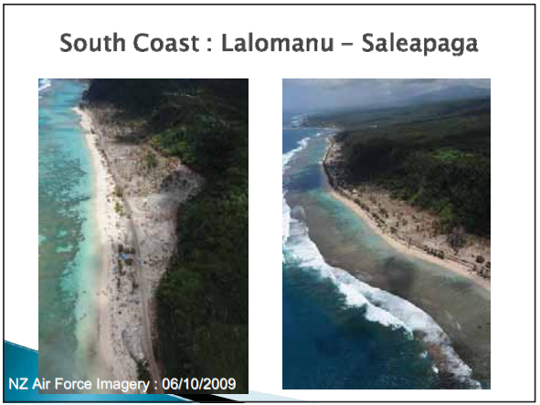
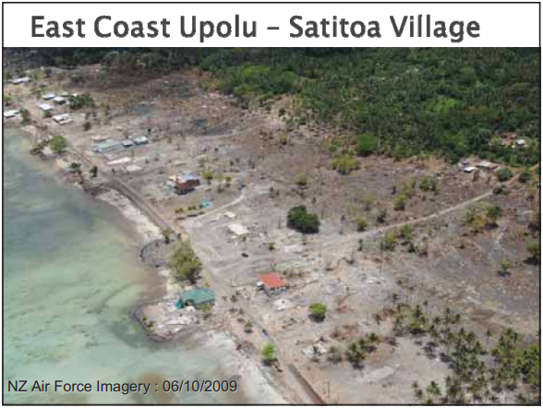
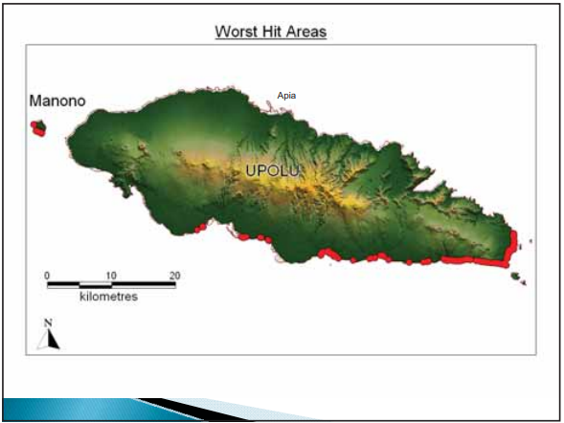
Worst Hit Areas

Slide 4
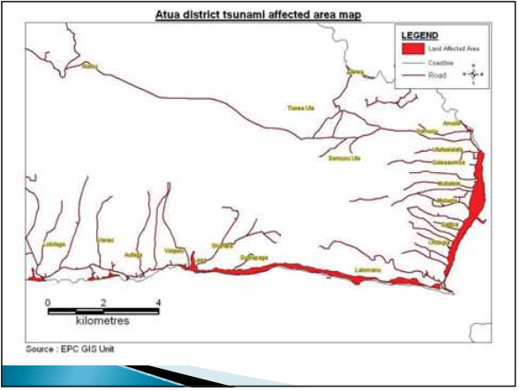
Affected Areas

Slide 5
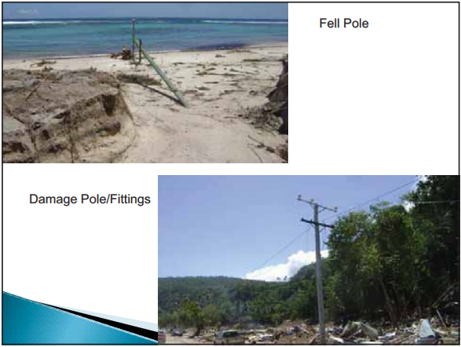
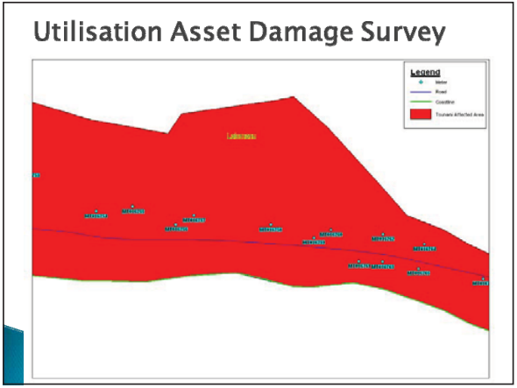
Query Assets in Affected Areas

Slide 6
Damage EPC Assets

Slide 7
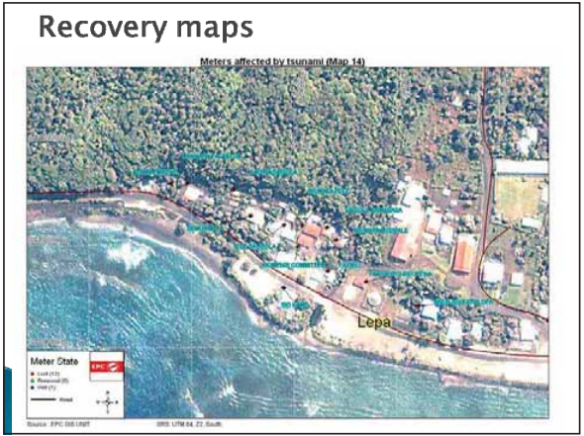
Secondary Results for NEOC

Slide 8
End
Questions?

