Slide 1





GIS USE CASES AND APPLICATION: EPC EXPERIENCE WITH QGIS (OSS)
- Clark Duseigneur, (GIS-OFFICER)

Slide 2
PRESENTATION OUTLINE
OVERVIEW OF EPC
EPC AND FOSS4G (2012-2020) – A SHORT HISTORY
EPC PRODUCTS FROM USING QGIS
EXPERIENCES – SHARING DATA, AND VIEWNG INFORMATION ON QGIS
LESSONS - MONITORING OPEN SOURCE FOR QGIS SOFTWARE, TECHNOLOGIES AND USAGE IN EPC

Slide 3
1. OVERVIEW OF EPC
It’s mandate and services and relationship with GIS

Slide 4
OVERVIEW OF EPC / BACKGROUND GIS
EPC
GIS
Mandate – to provide electrification services to all of Samoa
Motto: Power to the Nation
Vision: Clean Energy Sources for affordable and sustainable electricity supply for Samoa
Mission – To provide quality electricity services to support development of Samoa
2006: est. GIS in EPC (Alaoa Feeder pilot study, 2007)
Assets capture: 2007 - 2009
2010 Poweruser GIS was developed for wider access
2011 a telco app was developed for the co-sharing of assets on EPC Poles
2011 MOU for Data Sharing with Samoa Water Authority (SWA)

Slide 5
2. EPC AND FOSS4G (2012-2020)– A SHORT HISTORY-

Slide 6
2. EPC AND FOSS4G (2012-2020) – A SHORT HISTORY
2012: PostGIS, Geoserver, QGIS Desktop, WMS, WFS-T
2013 – 2019: OpenGeo Suite with Postgre/postgis, Geoserver and GeoEXT with plans to use Geoexplorer

Slide 7
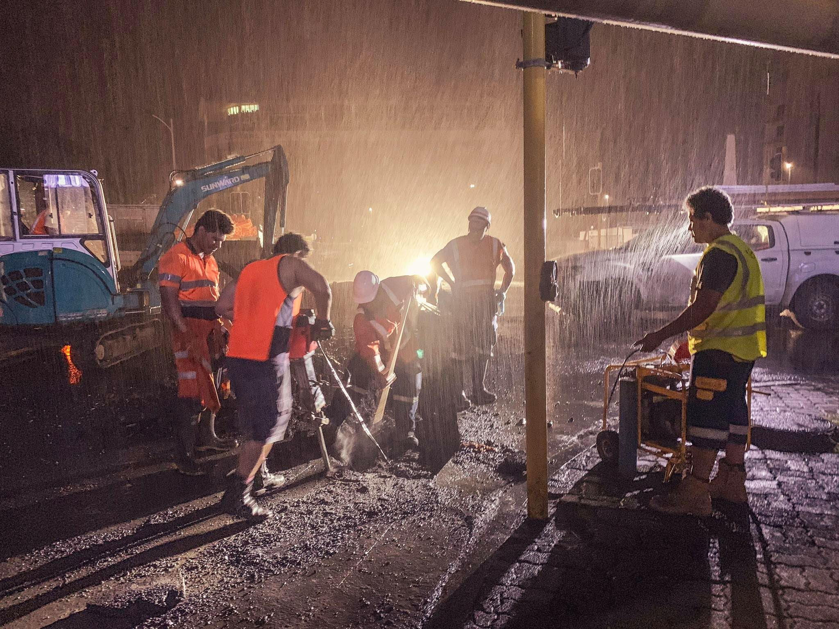

3. EPC PRODUCTS FROM USING QGIS (OSS)
Products and Benefits to EPC

Slide 8
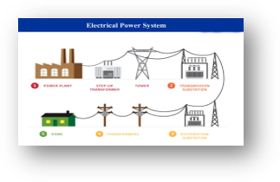
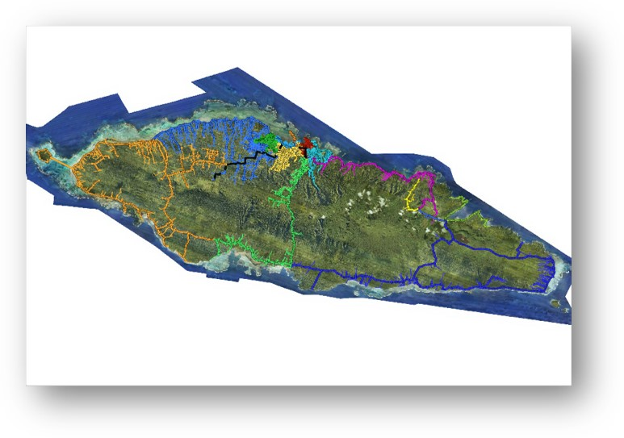
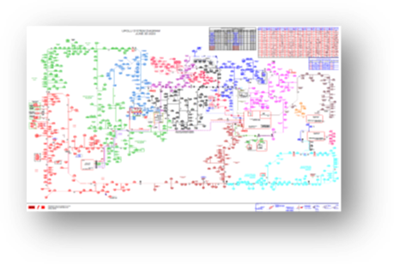
3.1 PRODUCTS: MAPPING THE EPC ASSETS & INFRASTRUCTURE
GIS Map of Upolu Electric Grid (High Voltage & Low Voltage Line)

Slide 9
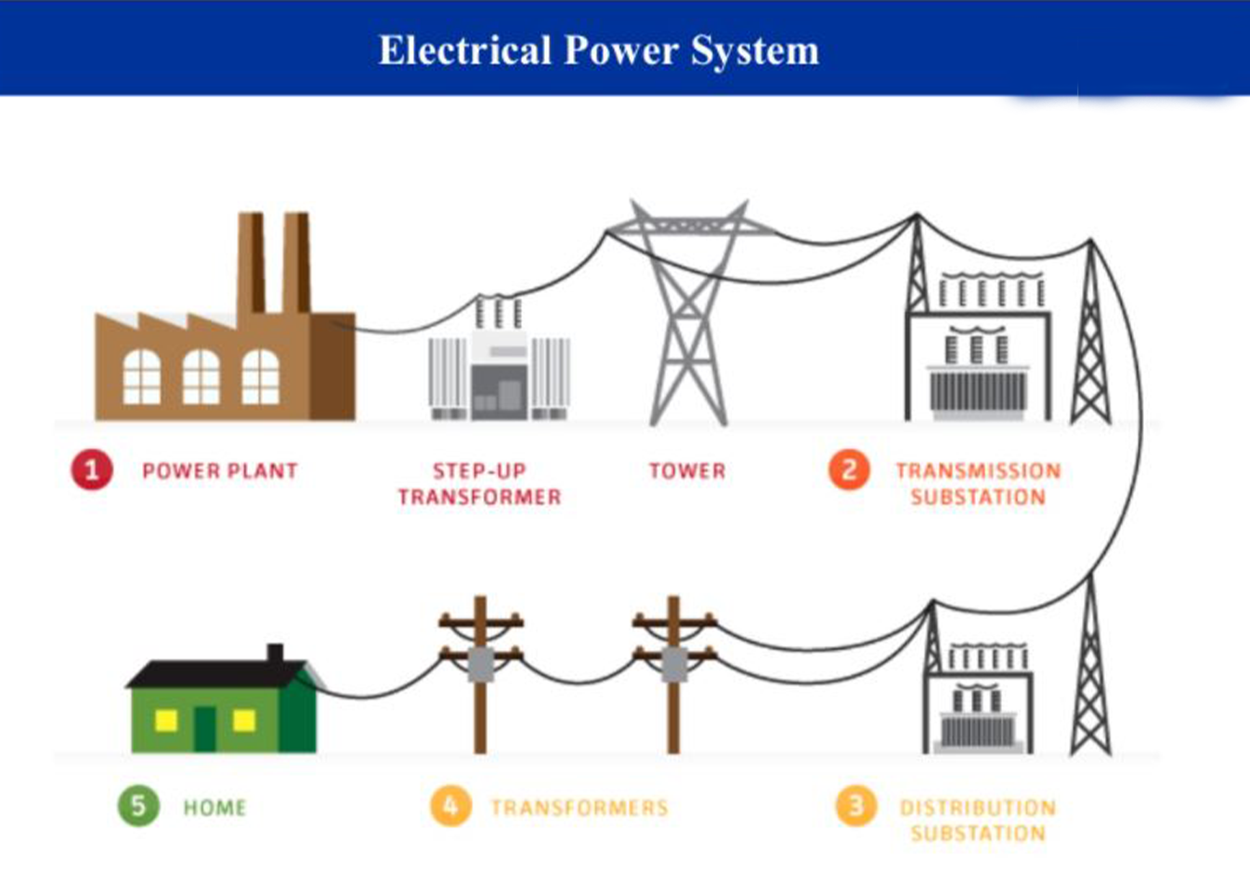
Mapping physical assets: from power plan to home
Notes:
PIC (METER)
PIC(POLE)
PIC(TRANSFORMER)
PIC (High Voltage Line)
PIC (LOW VOLTAGE LINE)
Meter
Pole
Transformer
High Voltage Line
Low Voltage Line

Slide 10
High Voltage Electricity Lines - QGIS: Single line diagram (Upolu System)

Slide 11
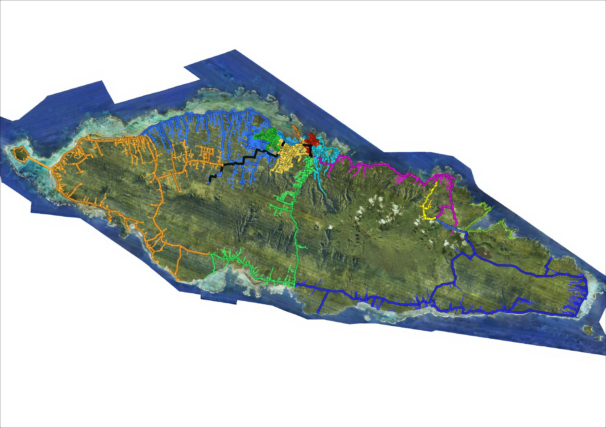
Upolu & Manono Is.: QGIS – single lines color coded

Slide 12

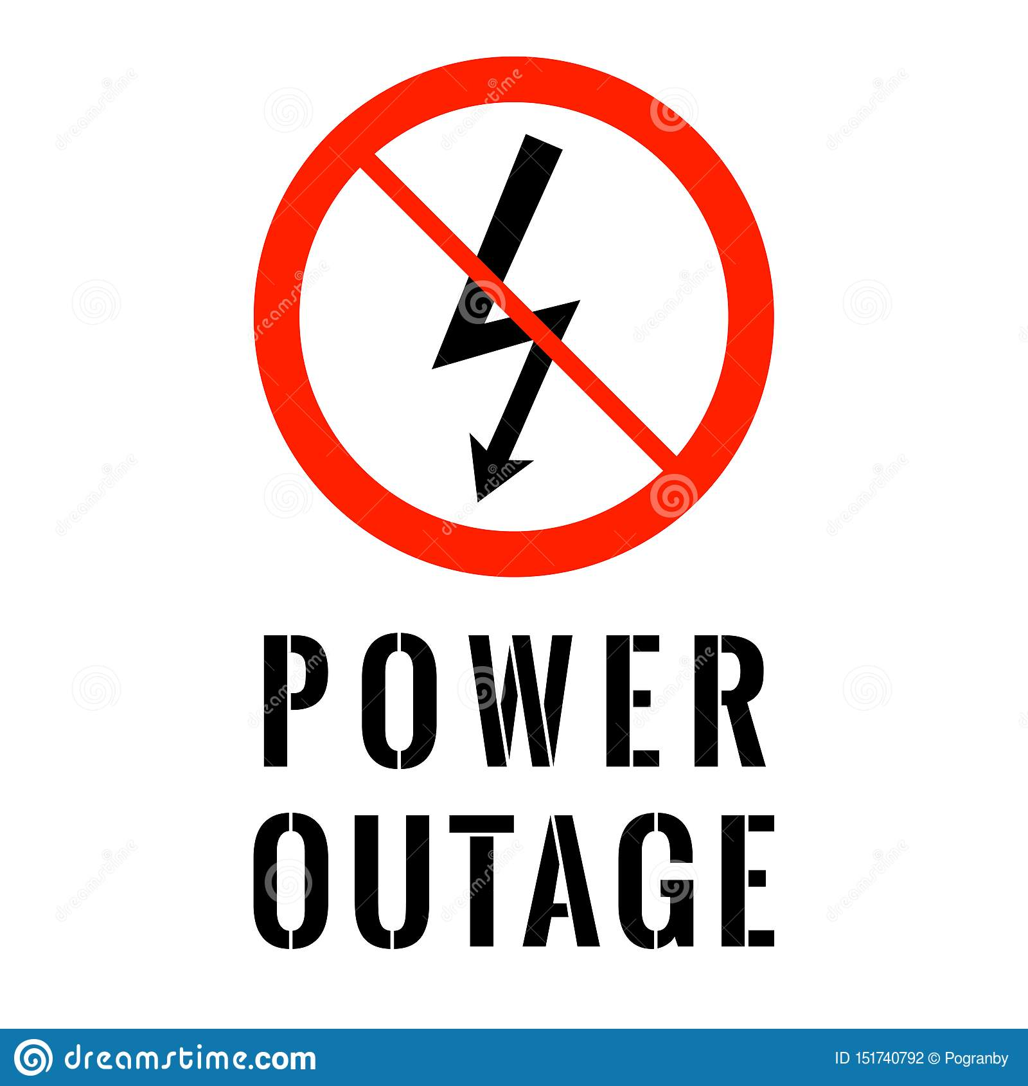

3.2 BENEFITS – USAGE OF DATA AND INFORMATION
Mapping outages, blackouts
  Disaster risk management, planning and maintenance
  Disaster preparedness and response (e.g., tropical cyclones, forest fires, etc.)
Consumer information
  Consumer location for rapid response
  Identifying electricity ‘leakages (power loss )
  Assign Customers to each Correct Feeder.
Pinpoint Accuracy of Asset
  Ability to query and find location of Assets
  (e.g., which electricity pole has been damaged, identifying UG Assets etc.)

Slide 13
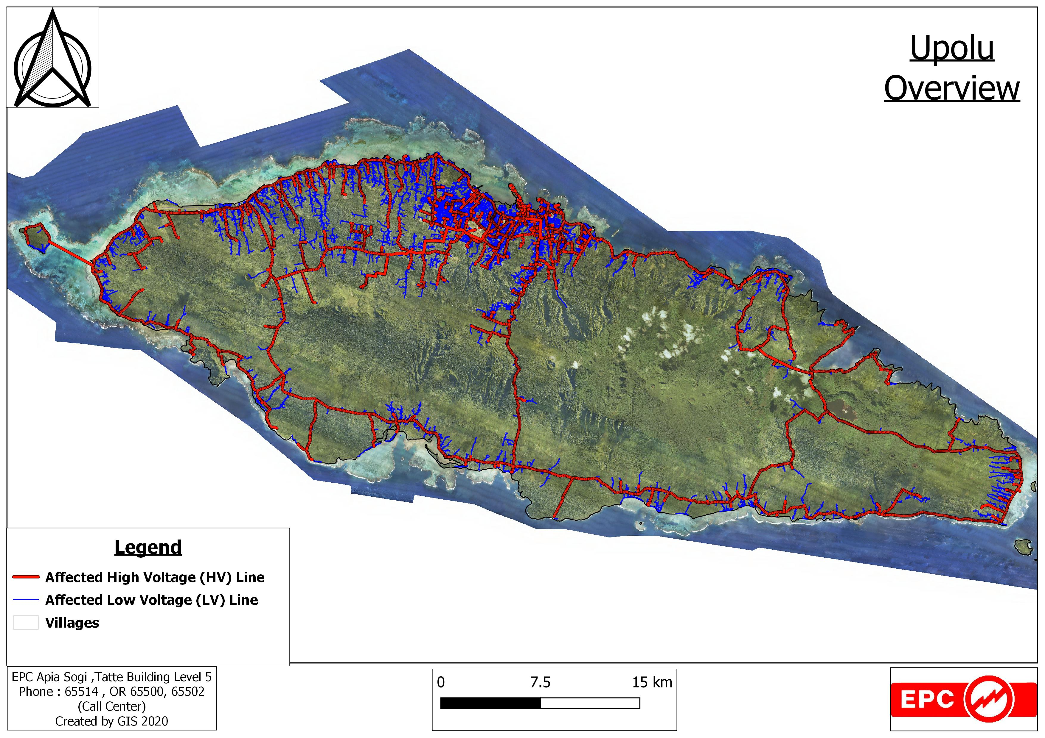
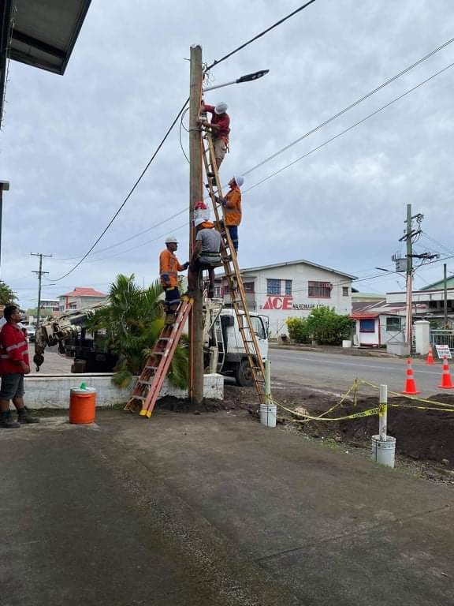
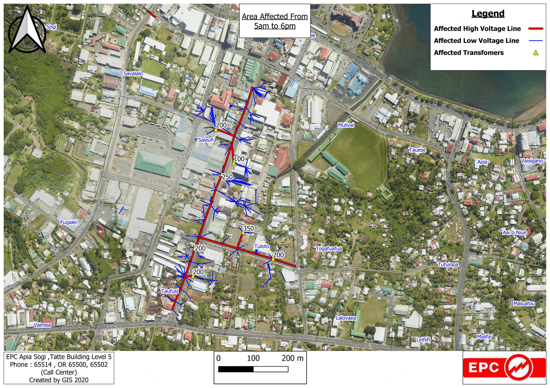
MAPPING OUTAGES
Map of Upolu Blackout
EPC Works for Vaea Street Project
Planned Outage for Maintenance

Slide 14
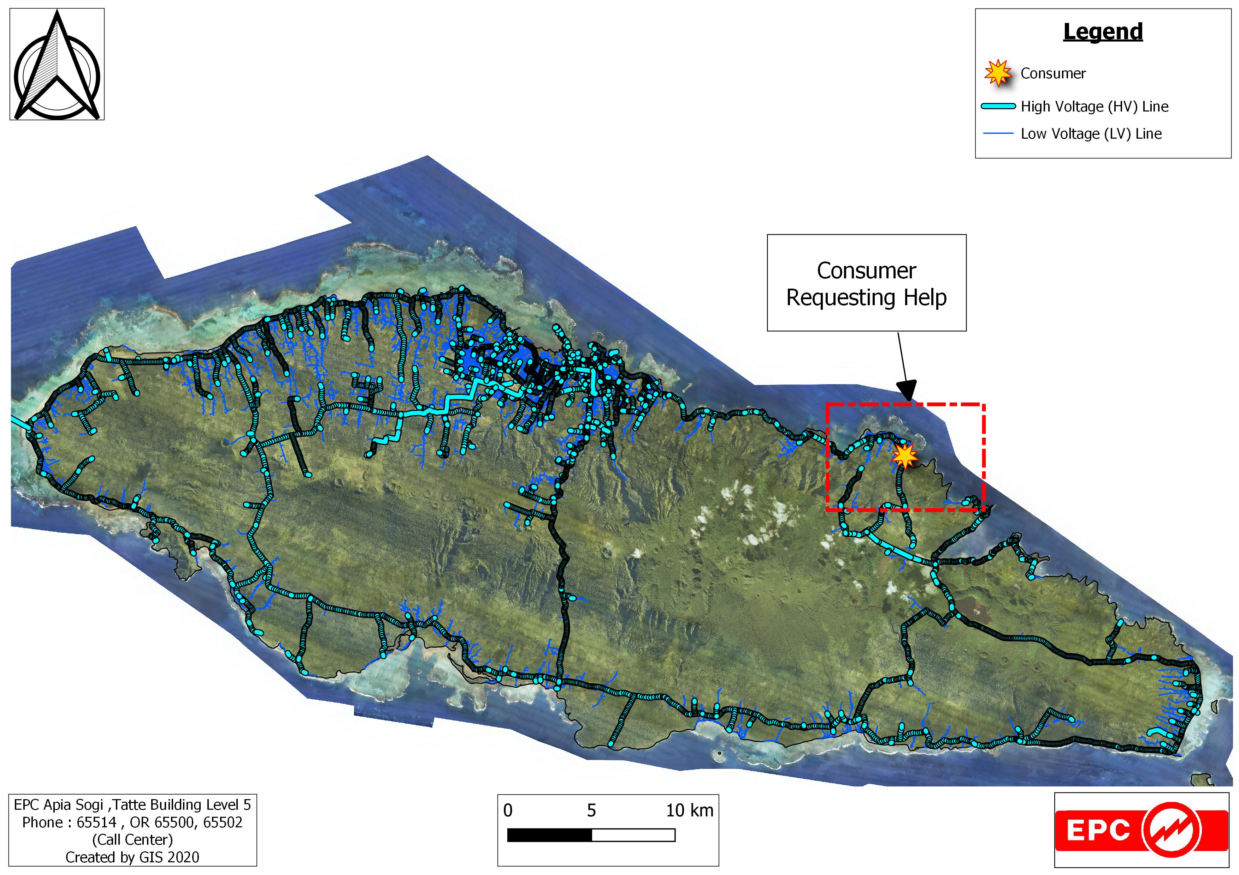
MAPPING CUSTOMER LOCATION
Map of Consumer in Need

Slide 15

MAPPING ASSET TO BE REPAIRED
Map of Consumer in Need

Slide 16
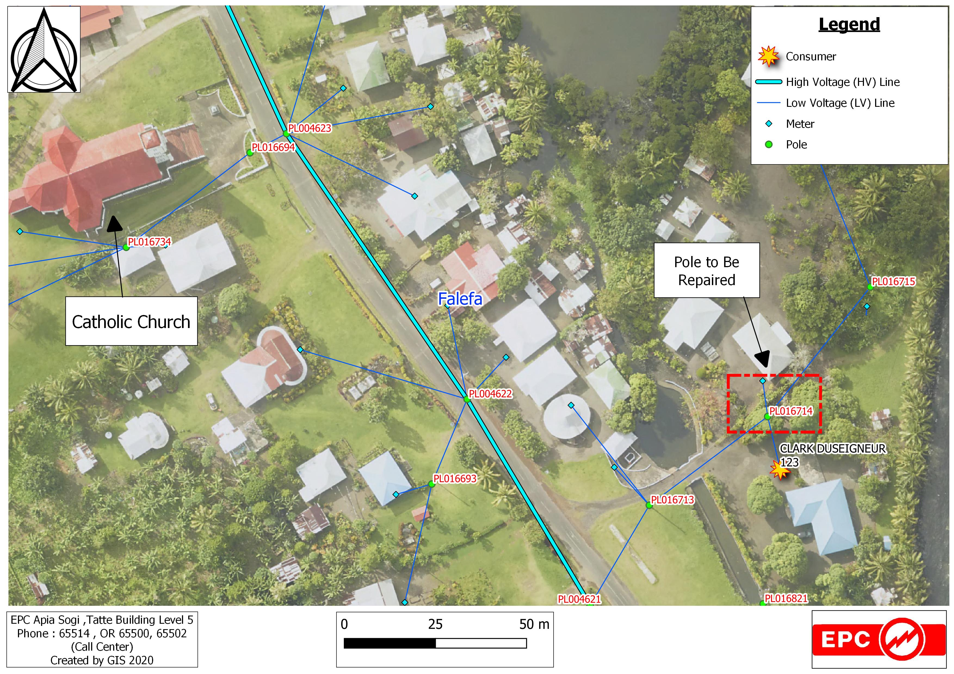
MAPPING ASSET TO BE REPAIRED
Consumer Request to have Pole Repaired

Slide 17
4. EXPERIENCES – SHARING DATA,AND VIEWING INFORMATION ON QGIS
Challenges and Opportunities

Slide 18
4. EXPERIENCES – SHARING DATA, AND VIEWING INFORMATION ON QGIS
Strengths
1 Easy to Use Interface
2 Free and New Updates is readily available.
3 Mapping out Large Datasets i.e. Consumer Database e.t.c
Weakness
1 Struggles with Large Datasets i.e. when calculating new attributes , tends to crash.
2 Hardware not sufficient to keep up with GIS Softwares i.e. Laptops

Slide 19
5. LESSONS - MONITORING OPEN SOURCE FOR QGIS SOFTWARE, TECHNOLOGIES AND USAGE IN EPC
Lessons learned

Slide 20
5. LESSONS - MONITORING OPEN SOURCE FOR QGIS SOFTWARE, TECHNOLOGIES AND USAGE IN EPC
Lessons learned
How is EPC monitoring the usage
How EPC is keeping up to date with technology on GIS
IOT / AI: Evolution of technologies within the geospatial programming
Data Sharing between Ministries is Key

Slide 21
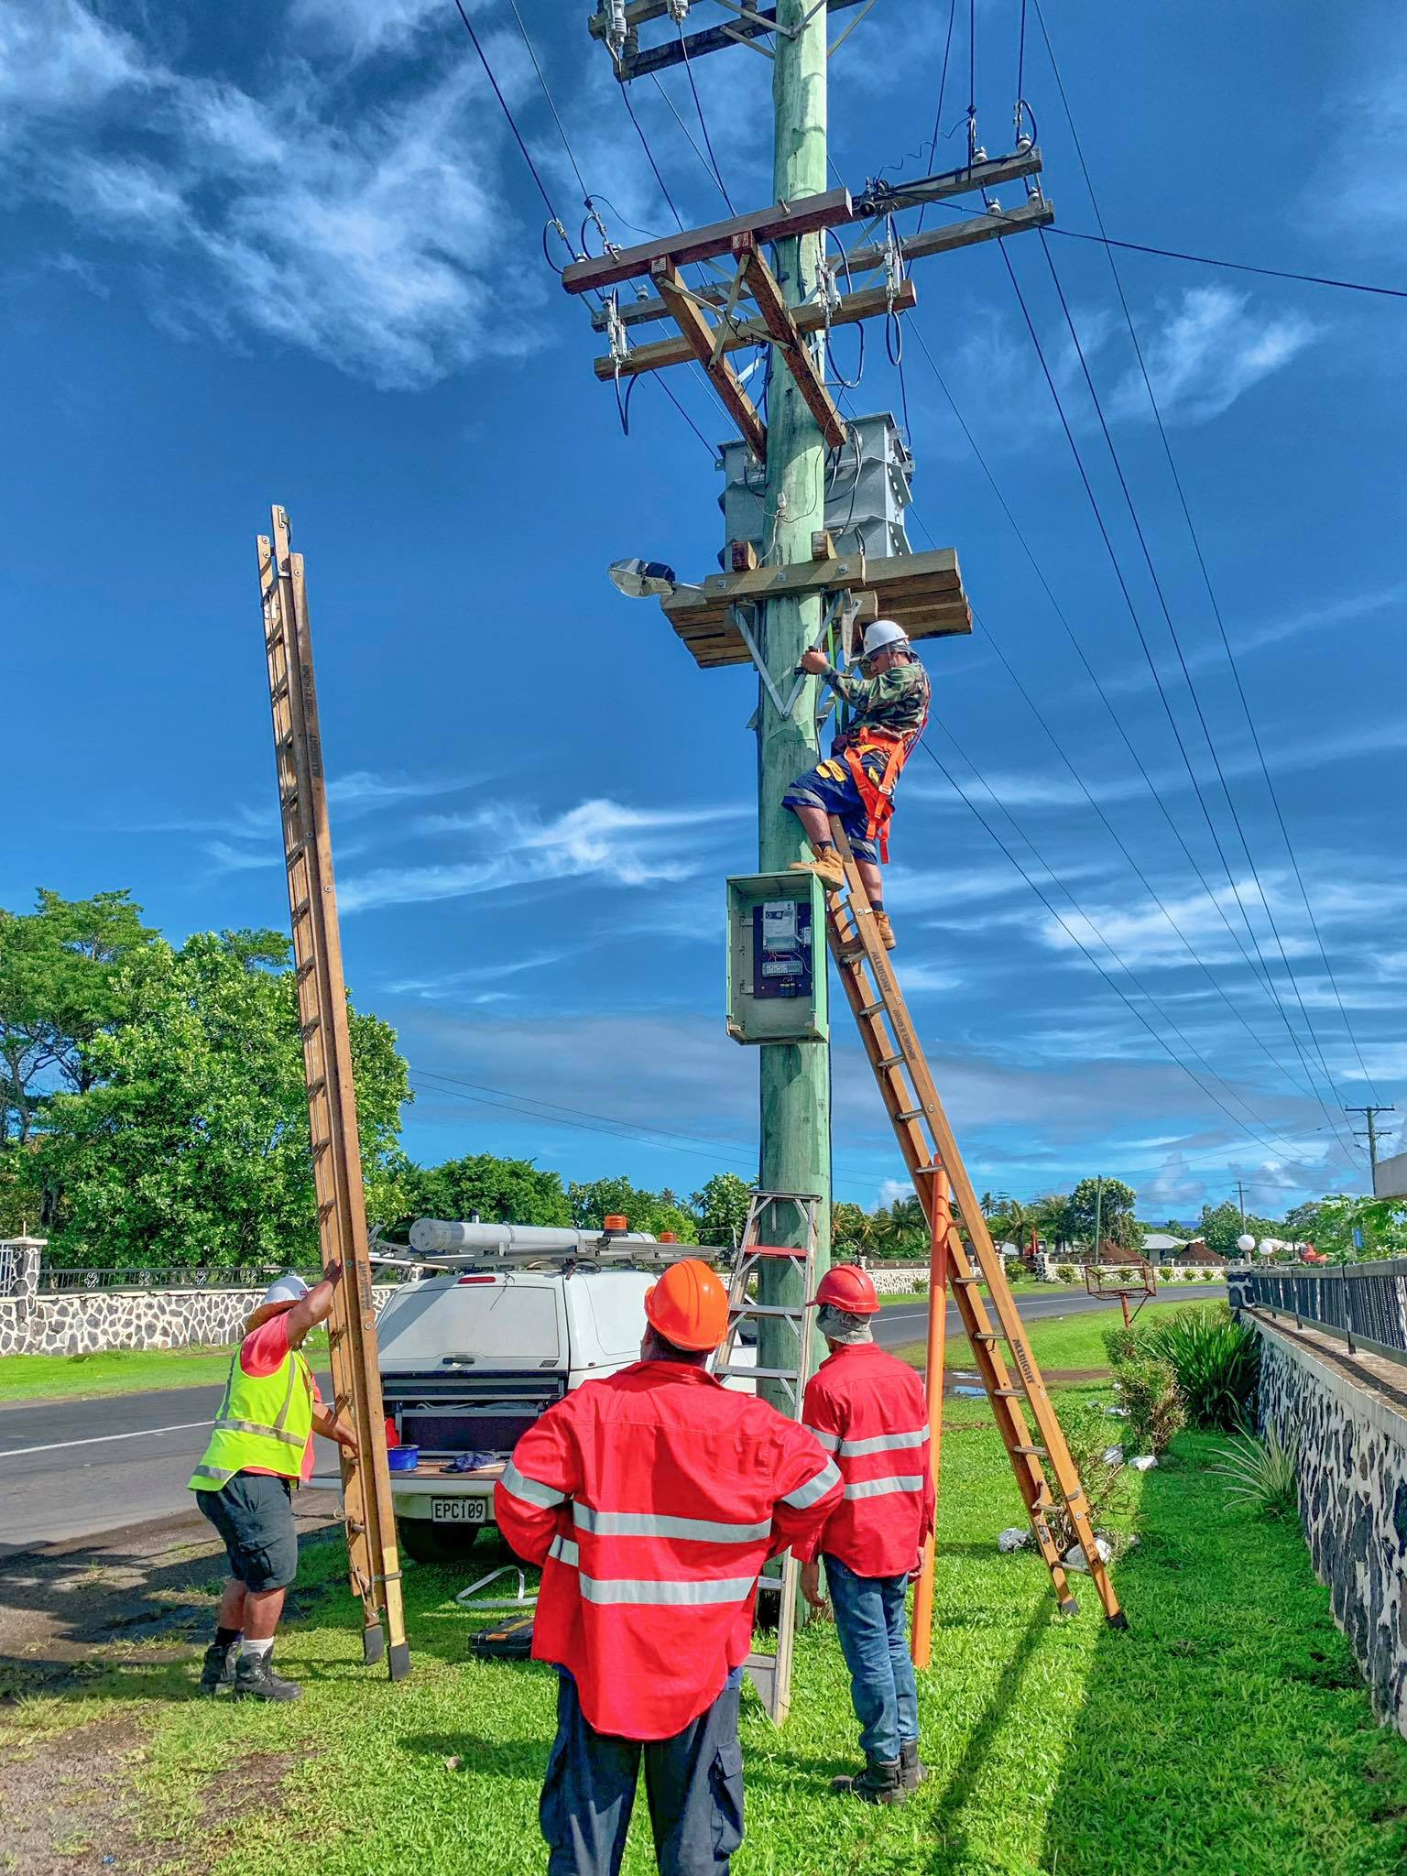
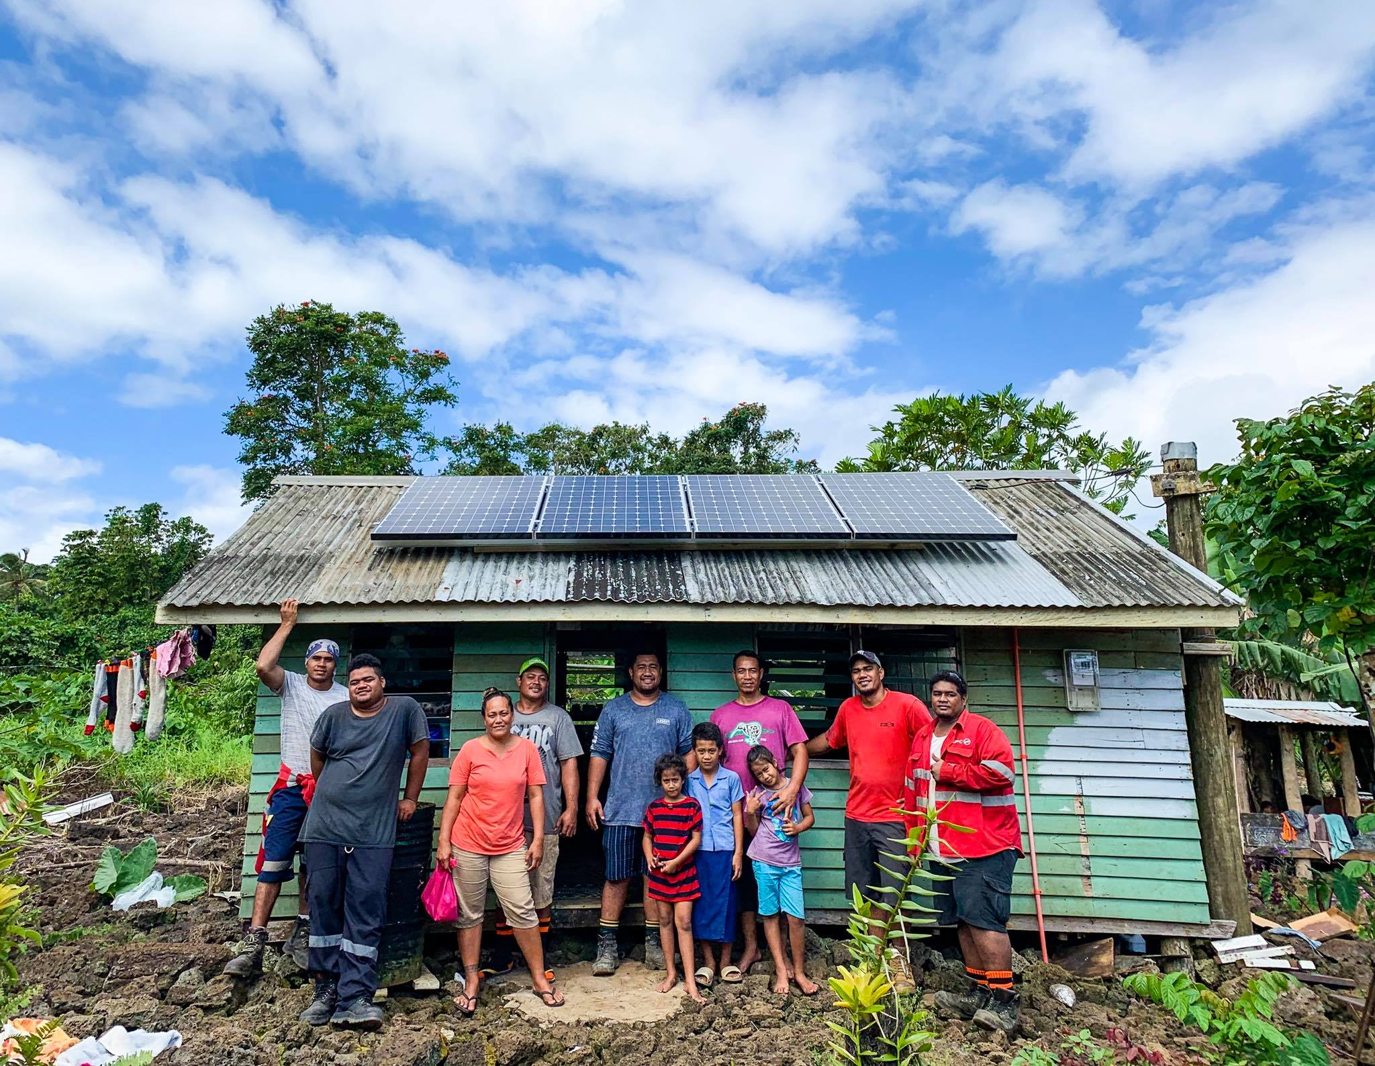
Thank you!
Clark Duseigneur
Upgrade Works for Transformer
EPC Standalone Solar

