Slide 1

GIS often branches into many different sectors

Slide 2
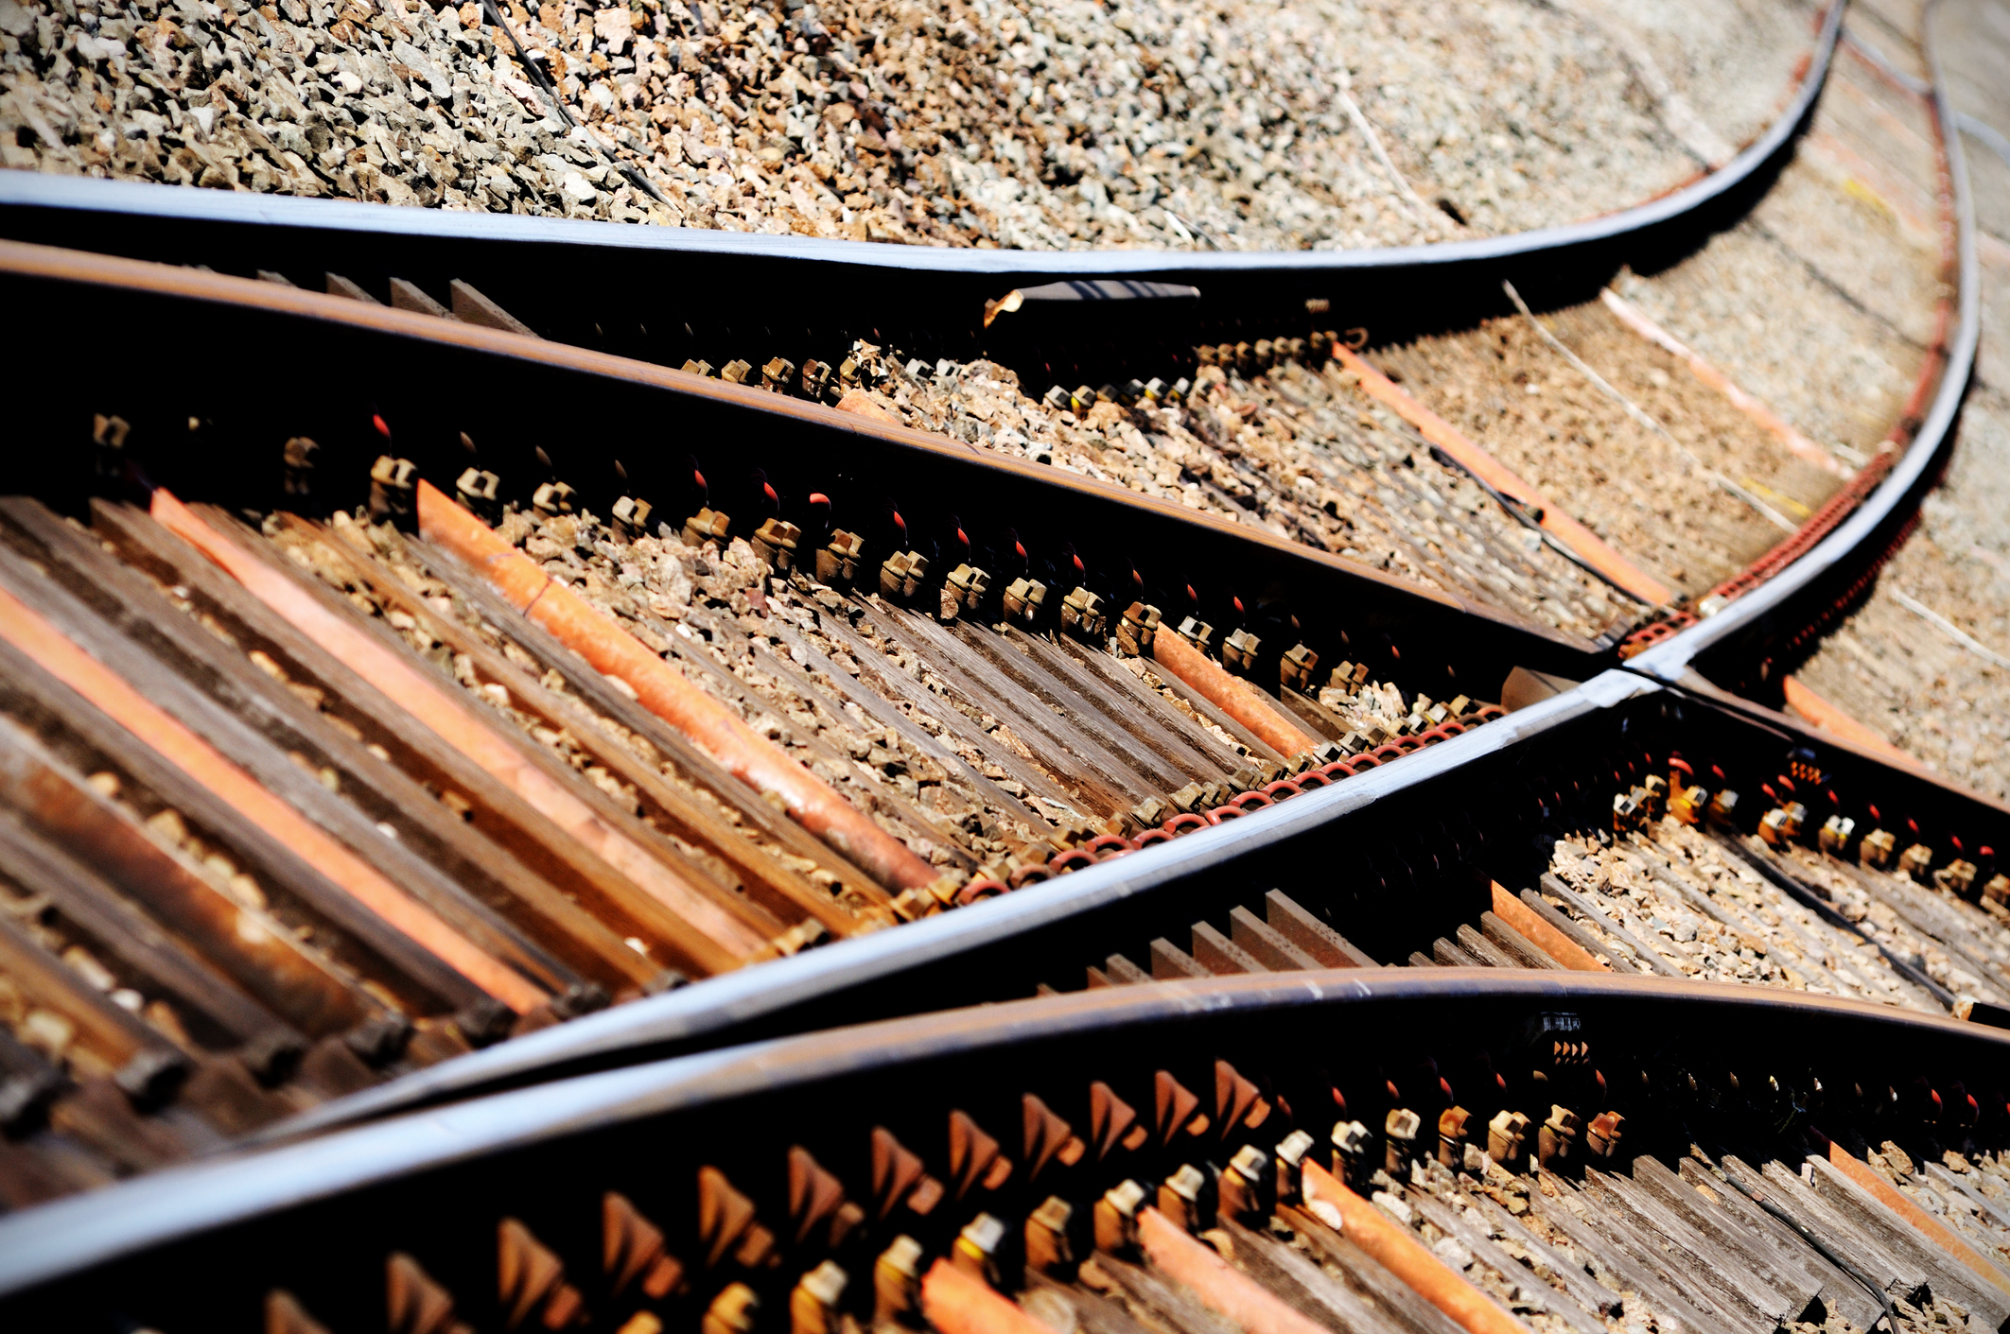
…but there is value in coming together from time to time to learn from each other

Slide 3
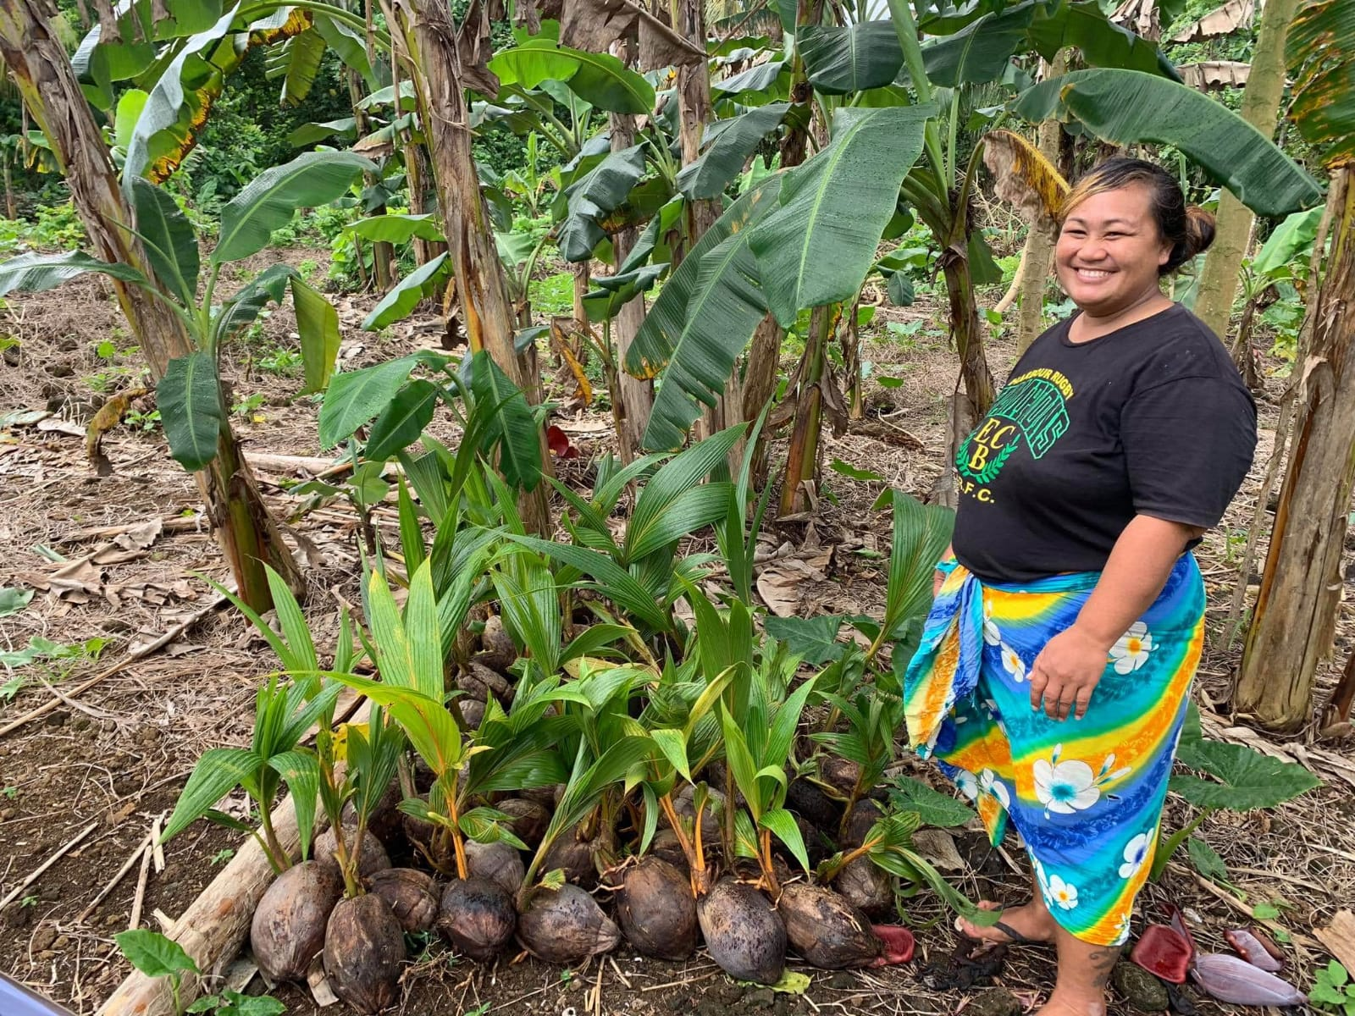
In comparison to recent Q1s, taro exports are solid
Exports
Using QGIS for a Local-Based Agriculture Project (MGP-SAFPROM)
FOSS4G Oceanic Conference - Samoa
20th November 2020
584t
411t
389t
353t
Tonnes (1,000kgs)
171t
Q1 2016
Q1 2017
Q1 2018
Q1 2019
Q1 2020
Data: Quarantine Division; Samoa Bureau of Statistics

Slide 4
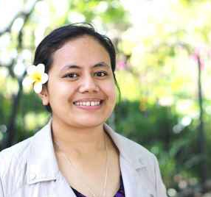


About Me
Hi my name is To’oa F Brown
GIS Work experience
Delivery Leader/Data Analyst (Delivery Associates/MAF)
Asset Management Consultant (LTA)
GIS Specialist (Skyeye Pacific)
Education
Bachelor of Science majoring in Geography & Environment (University of Auckland)

Slide 5
Project Background
The Matching Grants Programme (MGP) under SAFPROM helps poor farmers and fishers to increase their productivity and resilience
Context: The MGP is a critical deliverable for the Ministry of Agriculture and Fisheries. It is funded through the World Bank/IFAD agriculture sector support project.
Objective: Supporting poor farmers and fishers to become more commercially oriented.
Output: Provides financial investment in farming and fishery operations alongside technical and business support from local experts.
3300 applicants have registered for the first round of grant support with 1305 farmers approved for Y1
SAFPROM – Samoa Agriculture & Fisheries Productivity & Marketing Project

Slide 6
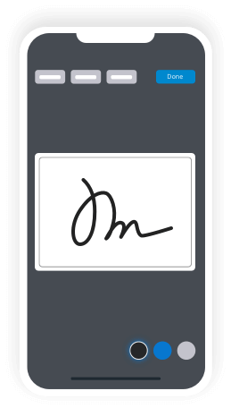

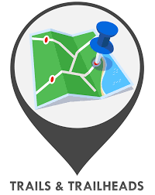
Digital Component allowed for faster data collection (saved the ministry time and resources)
Digital Component
Digital Component Process
Digital Form
(using KoboToolbox for data collection during Verification Visits)
Mapping using QGIS
Excel Outputs
KoboToolbox – also open-software for data collection purposes

Slide 7
Digital Component
Digital Component (DC) saved MAF up to ~1100 working hrs
The digital component speed up these visits. This innovation halves the time spent per farmer (from 40mins to 20mins).
Over the course of 3300 planned farmer visits, this amounts to 1100 working hours saved compared to using traditional manual systems.
Without DC
With DC
~40min per applicant farmer
~20min per applicant farmer
Field
work
Interview
Discussion with applicant
Interview
Discussion with applicant
25min
20min
Take notes (paper)
Take photos (manual)
Input data to app + upload
Notes direct to app; GPS auto-generated; photo integration; upload direct to database
Results linked to excel output automatically updates when refreshed on QGIS
Simultaneous to interview
Simultaneous to interview
Office work
Data entry
+ Attach photos to database
+ Type up notes in office
Simultaneous to interview
15min

Slide 8
Maps Overview
Maps created using QGIS have been used in all MGP Steering Technical Committee & SAFPROM Advisory Committee meetings
Farmer’s GPS Locations & Maps weren’t initially part of the overall project process
However the maps proved to address some of the other underlaying issues the MAF team had concerns about, such as:
Display the locations & distribution of farmers who were visited and verified
Showing areas where awareness of the project had been strongest/weakest
Identify farmers using other people’s lands/farms to claim as their own farm
Display and visualize distribution of farmers based on different agricultural sub-sector (eg. crops, livestock, fisheries)
Show geographical progress of verification work and what areas (villages/districts) have been visited as verifications progressed

Slide 11
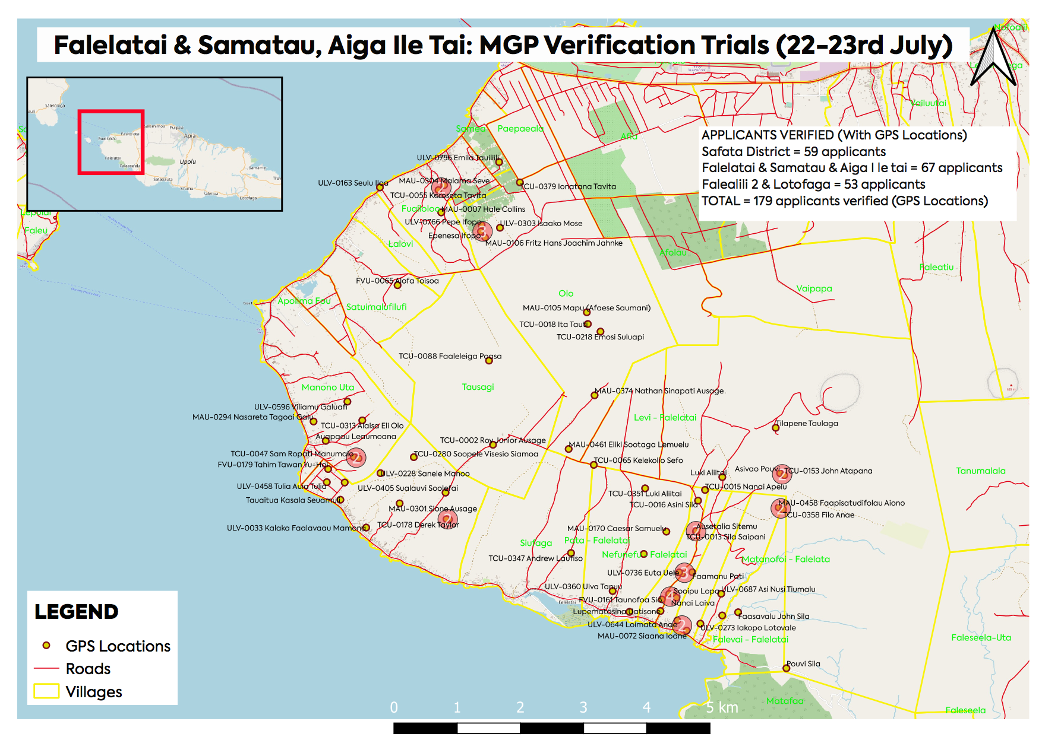
Maps
Map focused on west coast of Upolu (these maps were constantly updated to show progress) = PROVIDES MORE DETAIL

Slide 12
Lessons Learnt
What we’ve learnt from using maps in the MGP project
These maps have enabled leaders (eg. CEO MAF and minister) as well as donor partners (World Bank & IFAD) to became aware what's happening as the project progresses – more transparency
Map-making using QGIS has now become a part of overall M&E process of the project for reporting purposes
Maps addressed & solved underlying issues the project team had concerns about
Overall it has improved efficiency (using these open-source softwares) which has allowed for more focus on working with and getting help to the people that matter = farmers

Slide 13
With any technological solution, we always need to keep our key stakeholders top of mind.
Thank You and Faafetai Lava
norasplantationfoods.com

