Slide 1
GIS data for decision making
Paul Anderson
Notes:
We are really excited to participate in such a large and diverse meeting of GIS professionals.
Today we hope to reinvigorate the Samoa GIS user group, talk about some resources all members of the audience can make use of and share some regional opportunities you may find of interest.
Today I’ll provide a quick background on what GIS and remote sensing is and why it is of value to decision makers and technical officers.

Slide 2
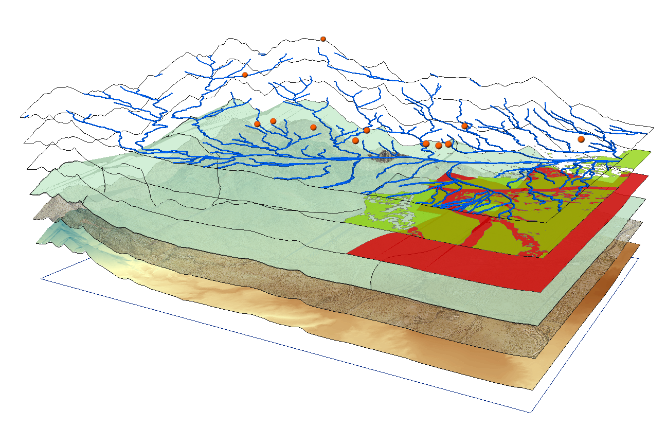
What is GIS??
Notes:
GIS is an information system technology with geography at its core foundation. Basically, its maps on the computer that you can interrogate.
GIS provides technology and methods for data integration, spatial analysis, and collaboration.
GIS also provides a science-based framework for organizing workflows that integrate all the factors that need to be considered for decision making. GIS improves the way we do our work by facilitating better decision making; saving money, time, and resources; and allowing us to more effectively communicate through geospatial visualization.

Slide 3
Remote sensing AllowS for the calculation of flood damage
Notes:
I’d be remise if I didn’t note the importance of Remote sensing – which is the scanning of the earth by satellite or aircraft in order to obtain information about it – Remote sensing, when combined with GIS provides users with a comprehensive look at landscape scale issues like Cyclone impacts.
Much of the data/information that we use in government and the private sector are spatially explicit- that is have a real world location.- UP to 80% of it

Slide 4
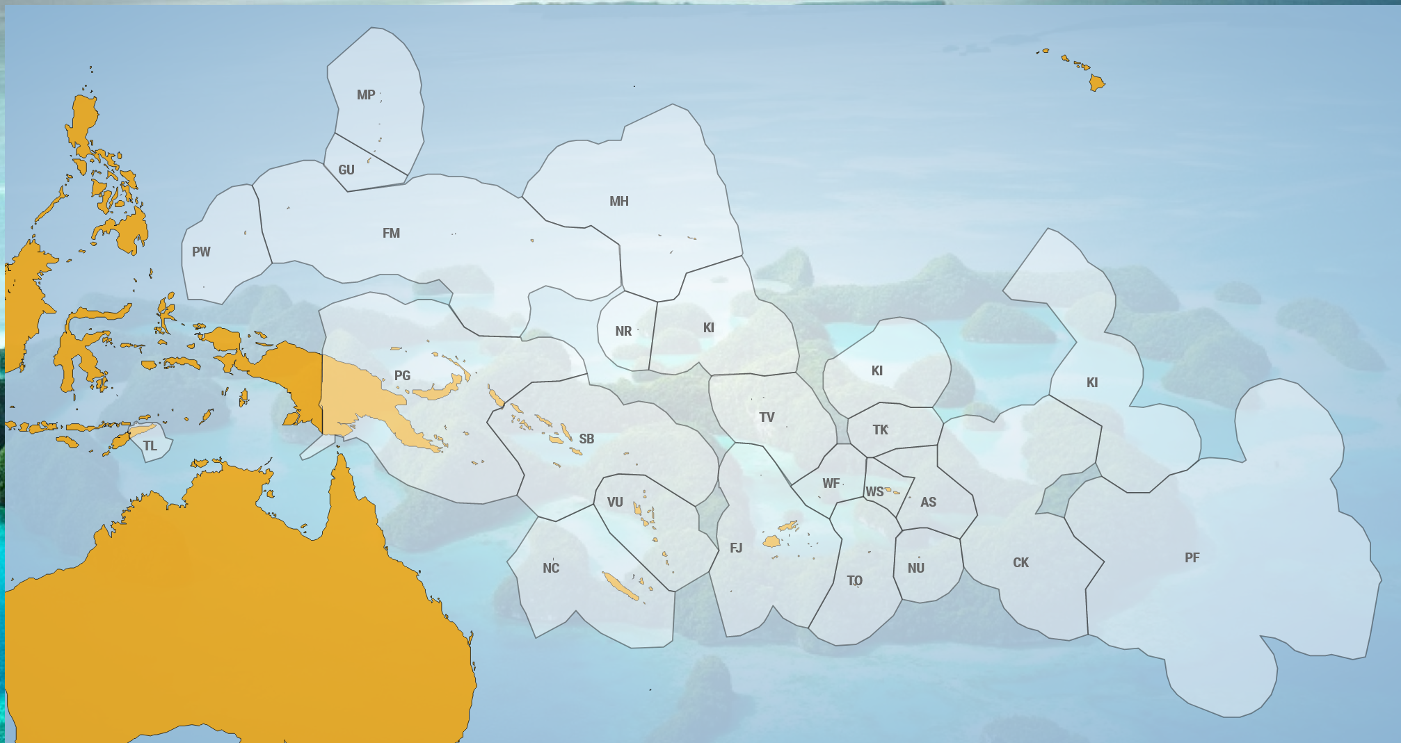
Regional Perspective
Notes:
One of the challenges throughout the region is one-time data use, data access and value adding to existing data and information. SPREP and its members are working to increase the use of high quality data including Spatial data, to support decision making, national and international reporting and tracking progress against SDG goals.

Slide 5
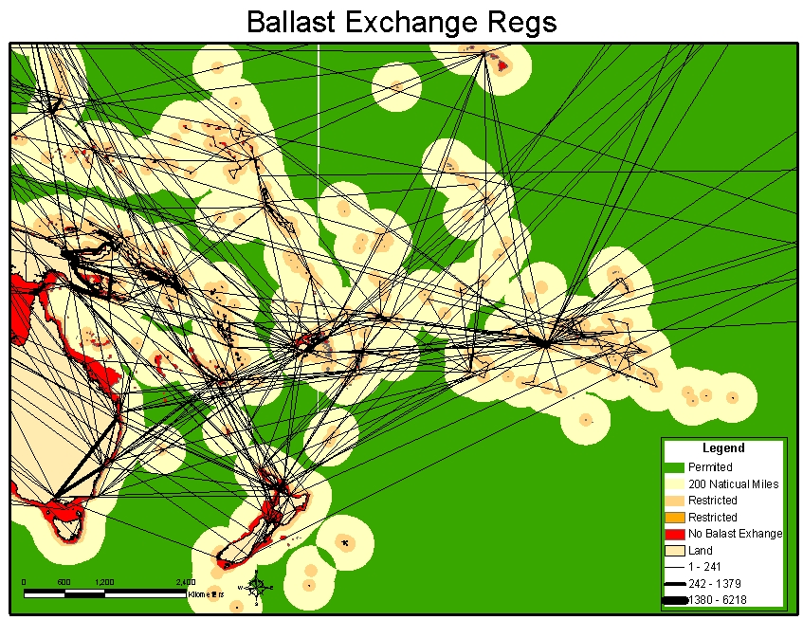
Notes:
At regional scale we use GIS to communicate challenges including shipping pathways

Slide 6
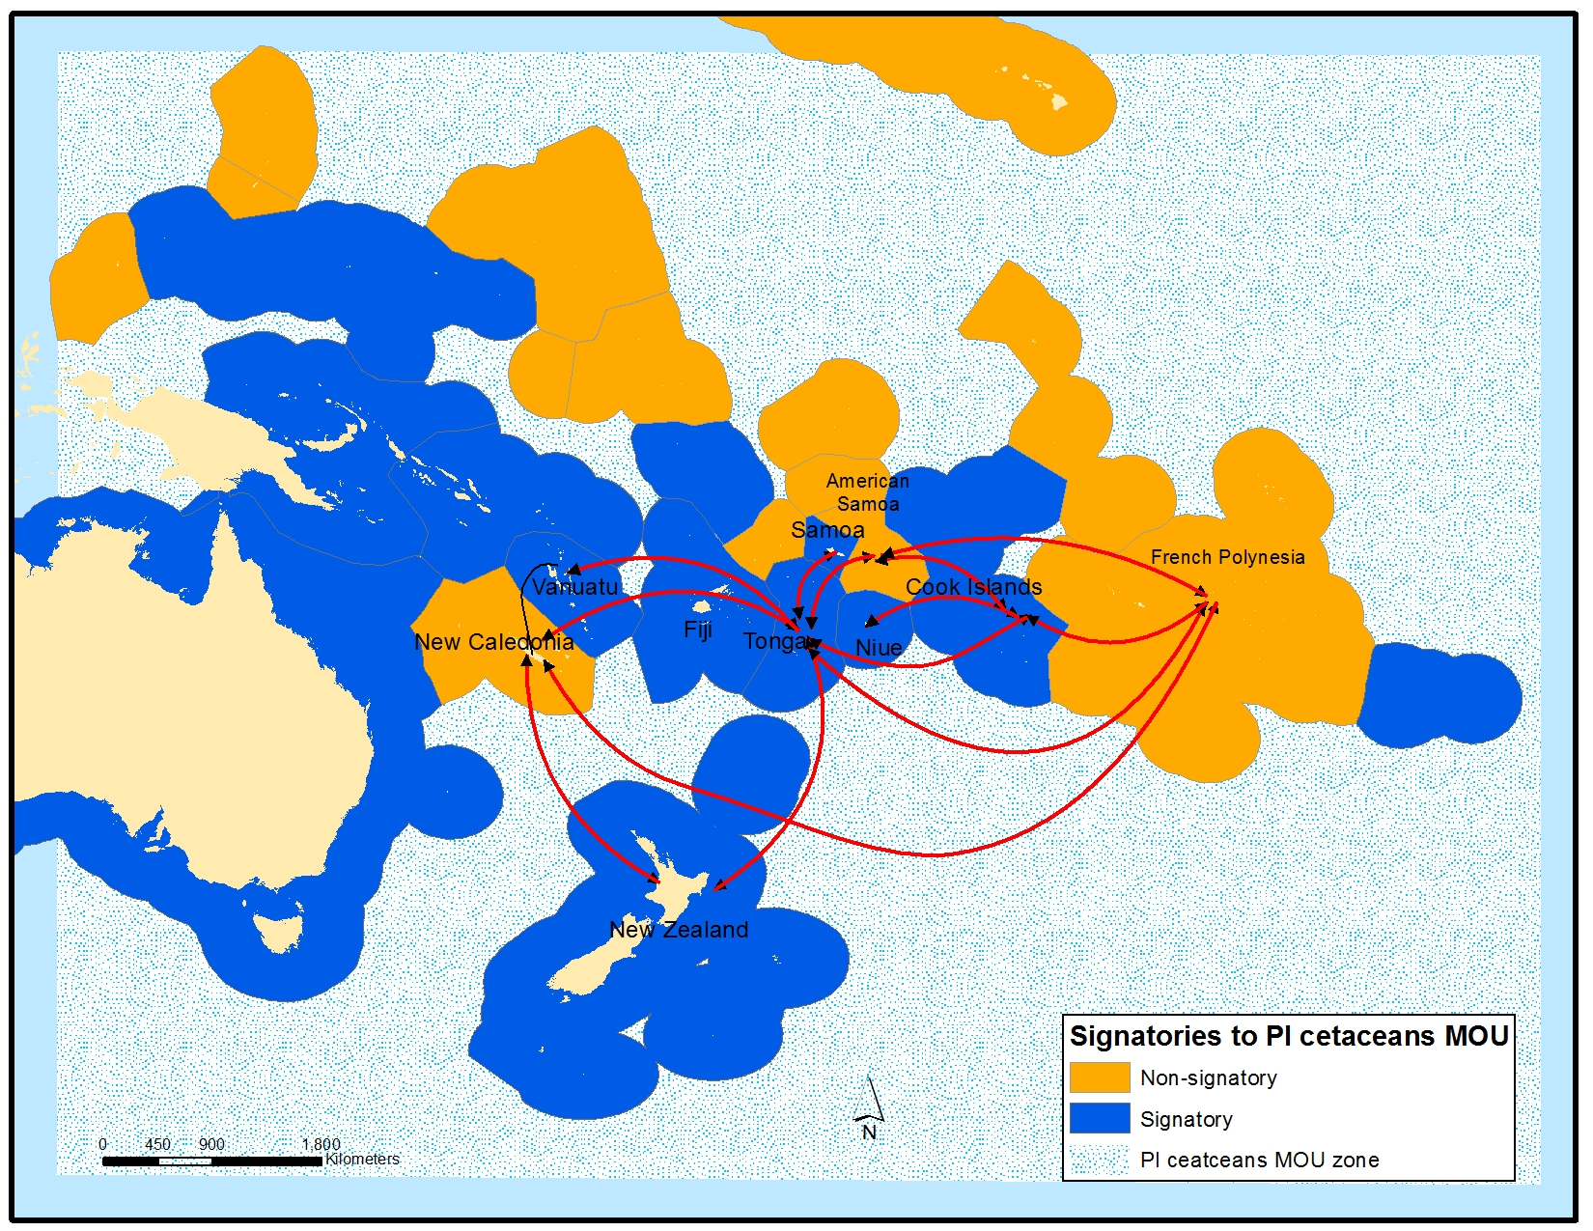
Notes:
migratory species routes and

Slide 7
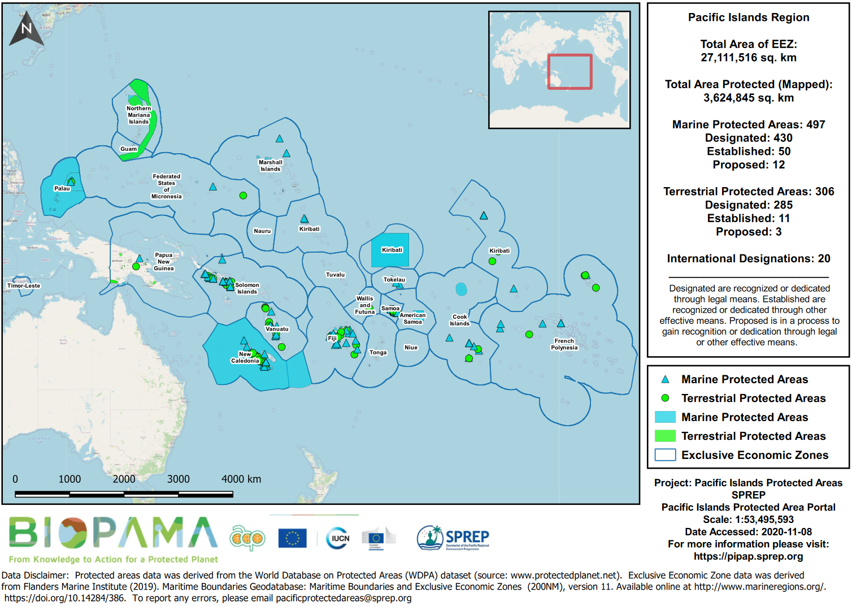
Protected areas
Notes:
illustrate progress on meeting national and regional commitments including to Multilateral Environmental Agreements like the CBD, Paris Accord under the UNFCCC and the delivery on SDG goals and targets.
We also strongly support the use of data, including Spatial data, in national and local decision making.

Slide 8
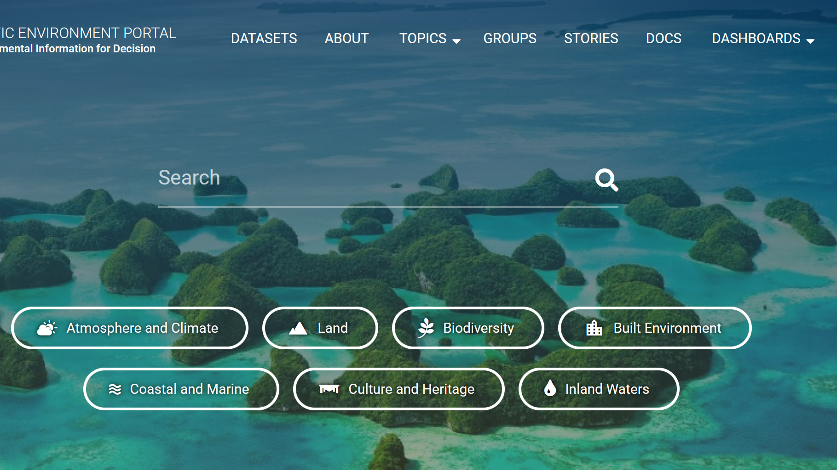
https://pacific-data.sprep.org/
Notes:
To this end SPREP has partners with other regional and international organizations to host 100s of open source GIS datasets to support you and others in making use of existing data and resources.
Decision makers and officers around the region already use GIS to inform decisions, save time and money and most importantly add value to data produced by their ministries and departments by working together to address challenges not individually but holistically.
At SPREP we’ve developed the Inform project with the 14 countries of the region, to help address some of the data availability issues. Storage, back up, sharing, and publishing can all be addressed in this network of data portals, and this includes a solution for spatial data.

Slide 9
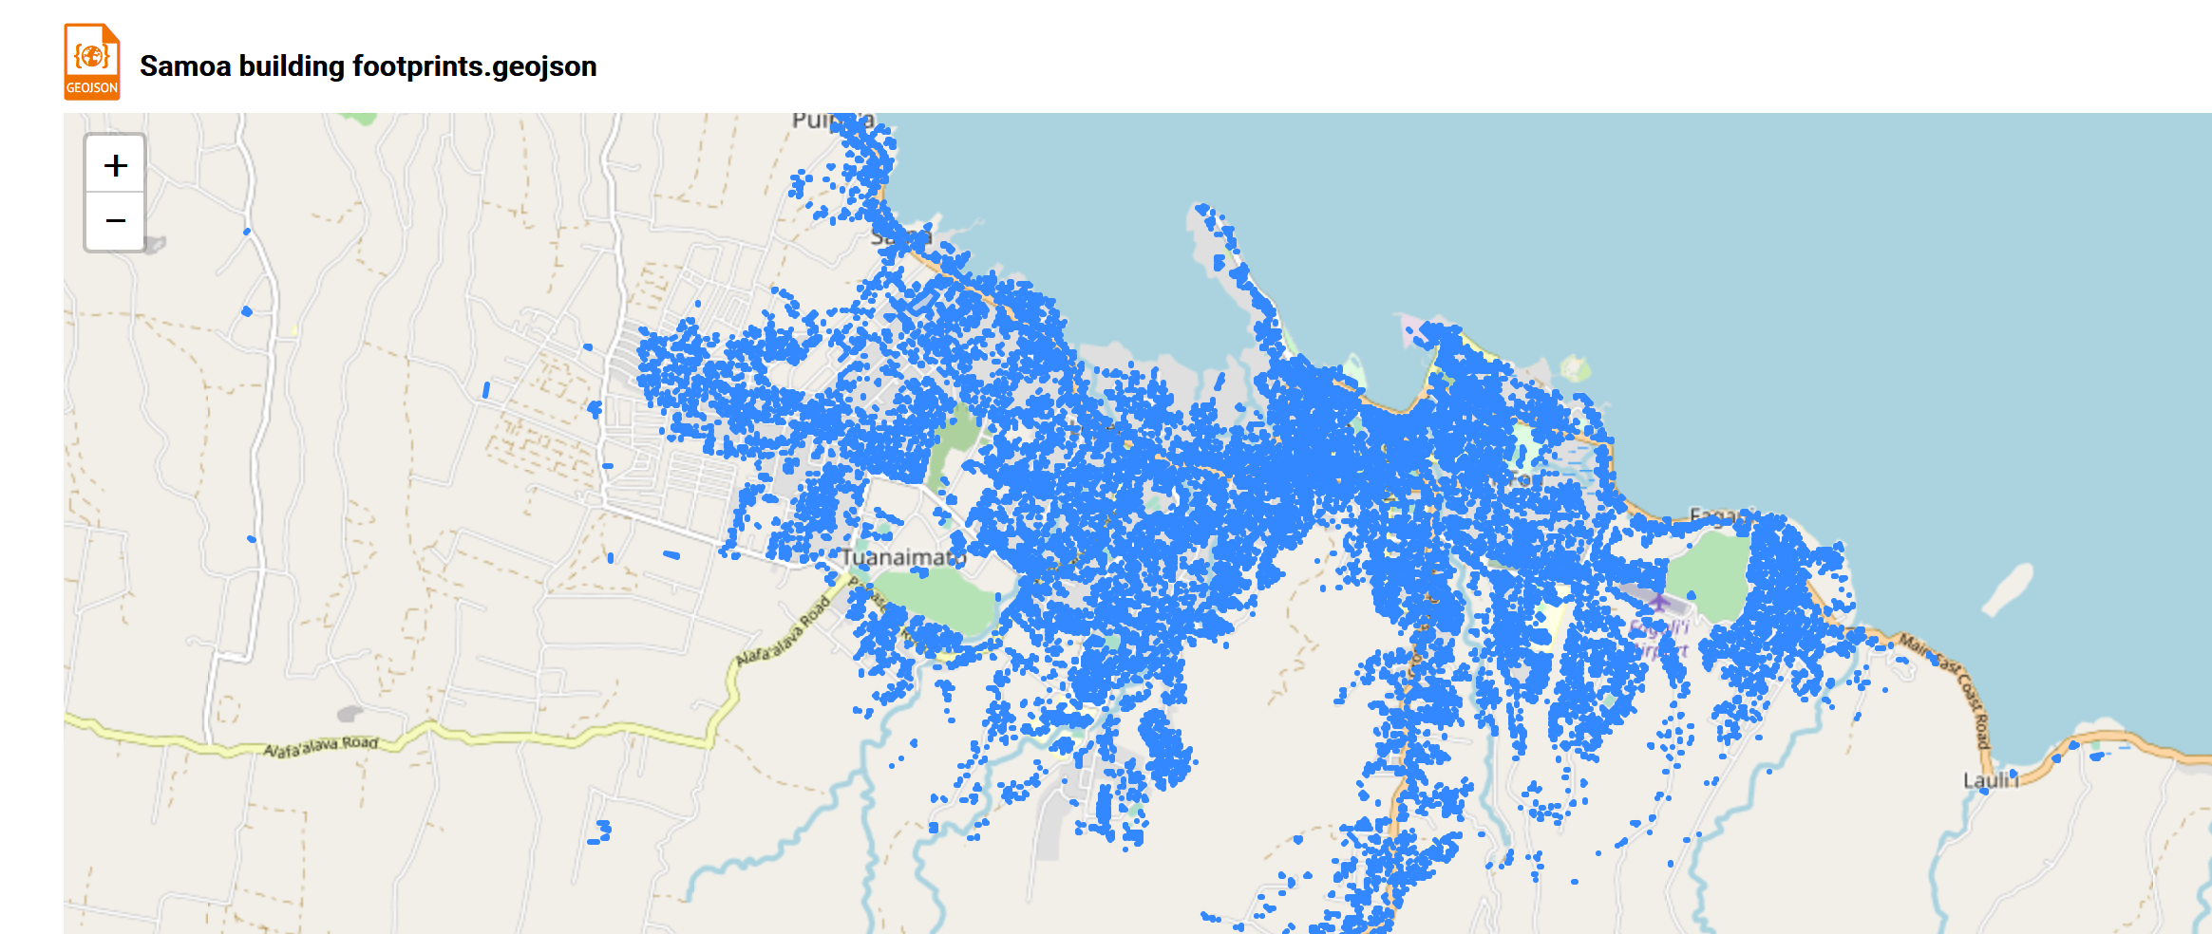
Notes:
An example - a SOPCA project, now GEM division of SPC, mapped all building foot prints for a insurance hazards assessment. This data set has many other potential uses as contextual data for a variety of sectors. We look forward to listening to the deliberations today to learn how we can best support and work with the Samoa GIS community to support wider availability of high quality data and it use in good resource management and decision making.
I’d like to now pass over to Mr James Atherton who will provide some insight on the national uses and history of GIS applications in Samoa.

