Slide 1
Pilot Application of GIS for Samoa December 2019 Mass Measles Vaccination Program
20th Nov 2020

Slide 2
Overview
2 day vaccination drive for Measles 5th and 6th Dec 2019
150 field collectors
Using Digital Smart Forms to Collect Measles Vaccination Info from the field
Using Digital Smart Forms GPS function to map location of where vaccine were administered
Smart Reports Dashboard and Analysis of collected data

Slide 3
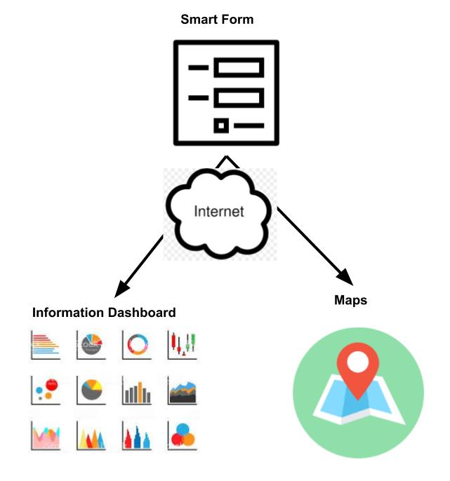
Architecture

Slide 4
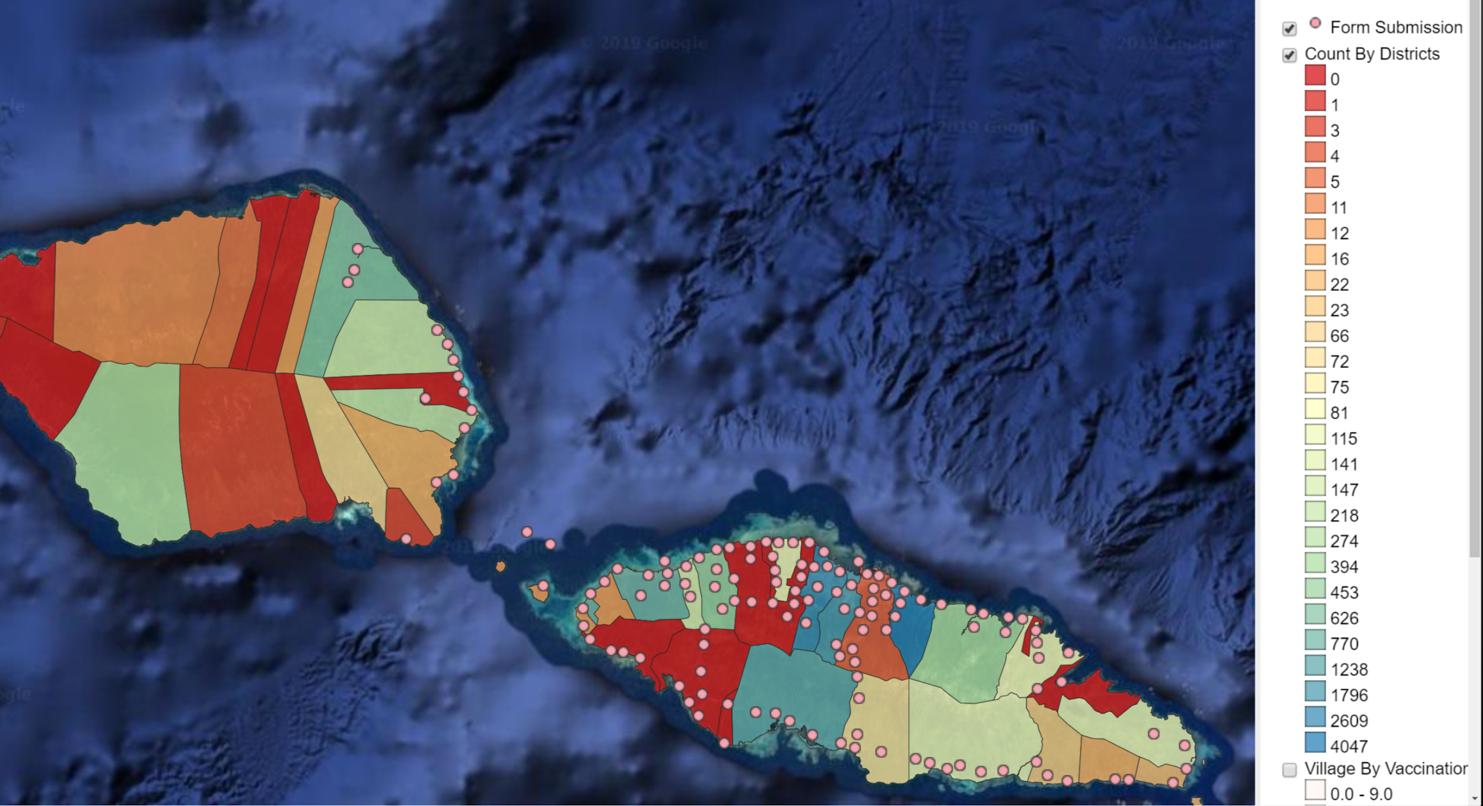
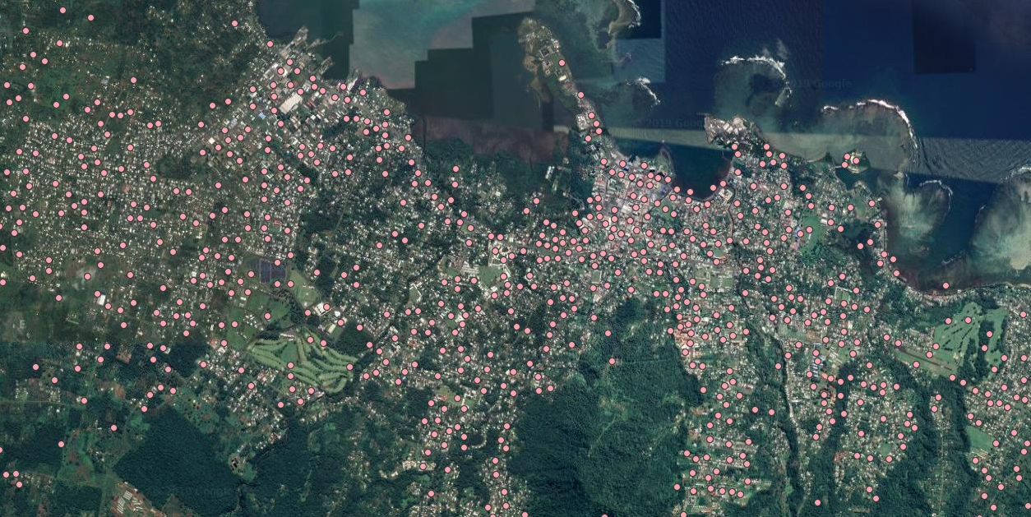
Maps

Slide 5
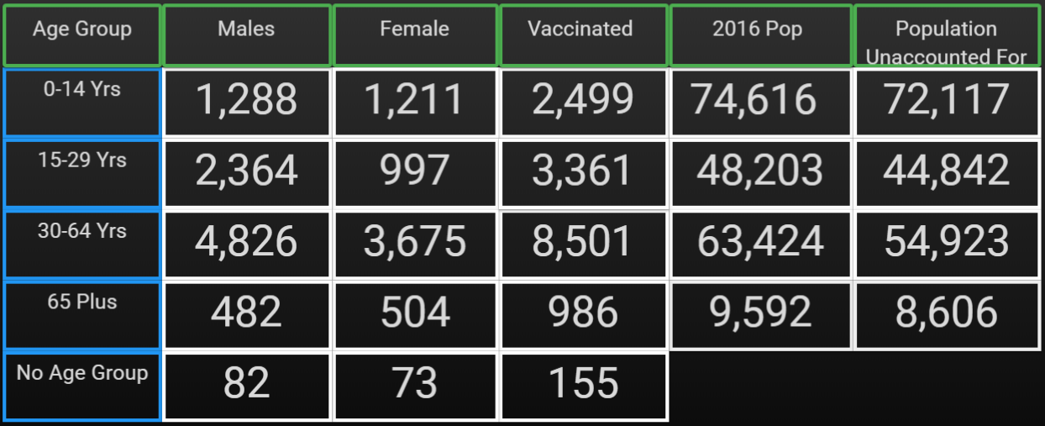
Analytics
Vaccination by age group
Vaccination levels by Age Group

Slide 6
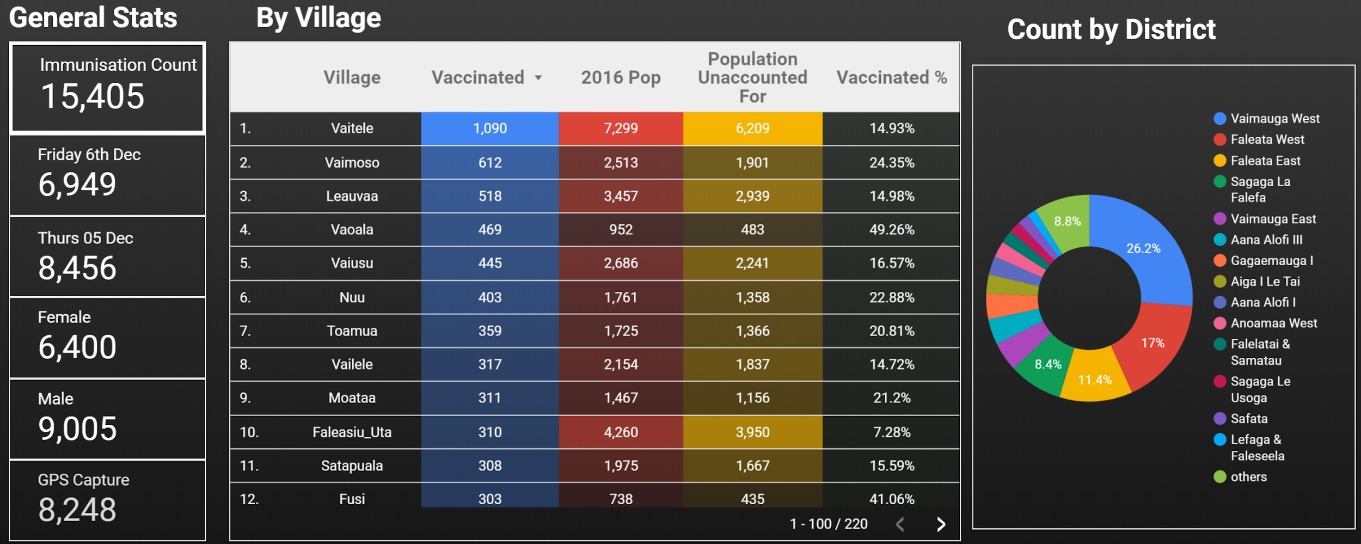
Dashboard

Slide 7
Key Results
Digital Forms(more than 15k submitted) - No paper forms to carry around
Inbuilt GPS function in forms means no need for dedicated GPS device to capture location
Validated fields reduced data entry errors
Live field upload of form data meaning no need for in office data entry (completed in 2 days)
Realtime stream of data with dashboard and analytics

