Slide 1
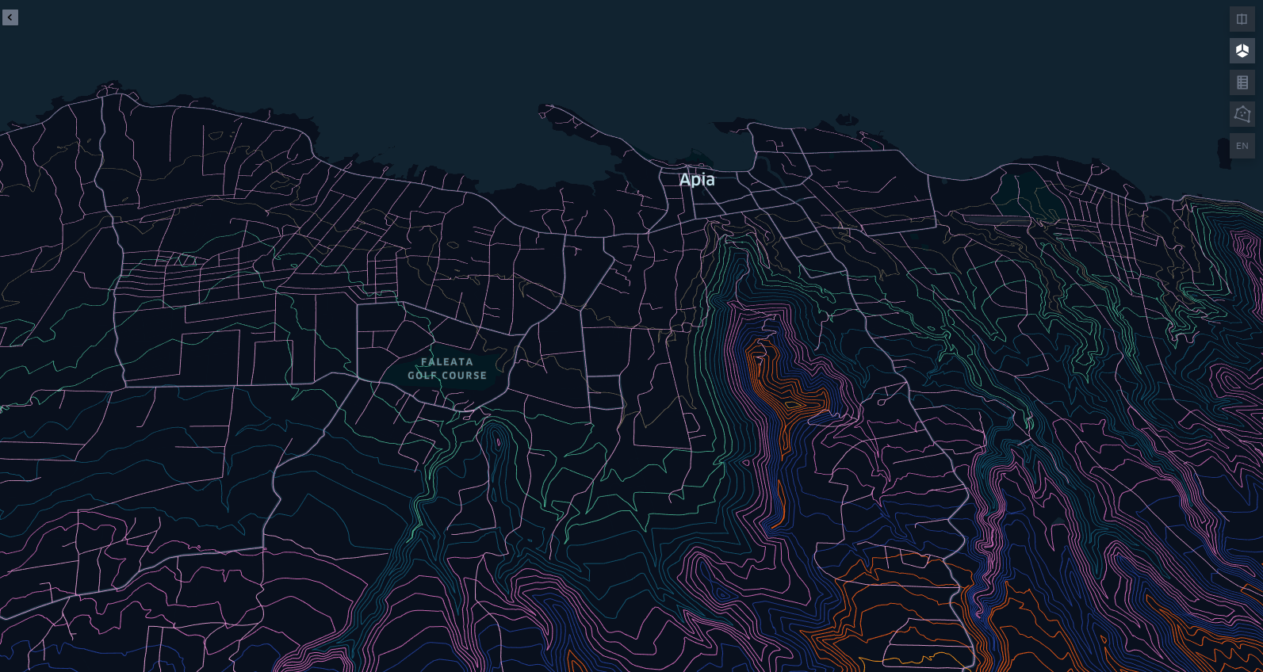
The Future, Where to for GIS for Samoa?
November 20th, 2020

Slide 2
Improve Spatial Data Data Management
Connect stakeholders/GIS practitioners to foster collaborative work through a Samoa GIS User Group
Need to do a stocktake of existing Spatial data repositories to increase awareness of available Spatial data in Samoa
Adoption a standards for Spatial data for example a coordinate system for Spatial data capture
1st Open Source approach to Spatial technology/standards not only for reducing cost but also for interoperability e.g OGC standard for sharing of Spatial data via internet

Slide 3
Develop a National Spatial Data Infrastructure
Framework for GIS Policy, People,Tools to enhance Spatial Data Management
Bible for GIS Practitioners in Samoa as well as any visiting GIS Specialist
Foundation for new technology which relies on spatial infrastructures such as IOT, Drone Delivery and Driverless cars for future economy

Slide 4
Apply GIS Nationally/Sectors - Growth Areas
Public Access to Samoa Street Addressing
Emergency Response GIS Application (Fire,Police,Ambulance)
NEOC GIS Application for Disaster Response/Relief
Utility Asset Management Application
Natural resource management
Conservation, terrestrial and marine
Management and monitoring of epidemics such as Measles and Covid
Online shopping- connecting vendors with clients

Slide 5
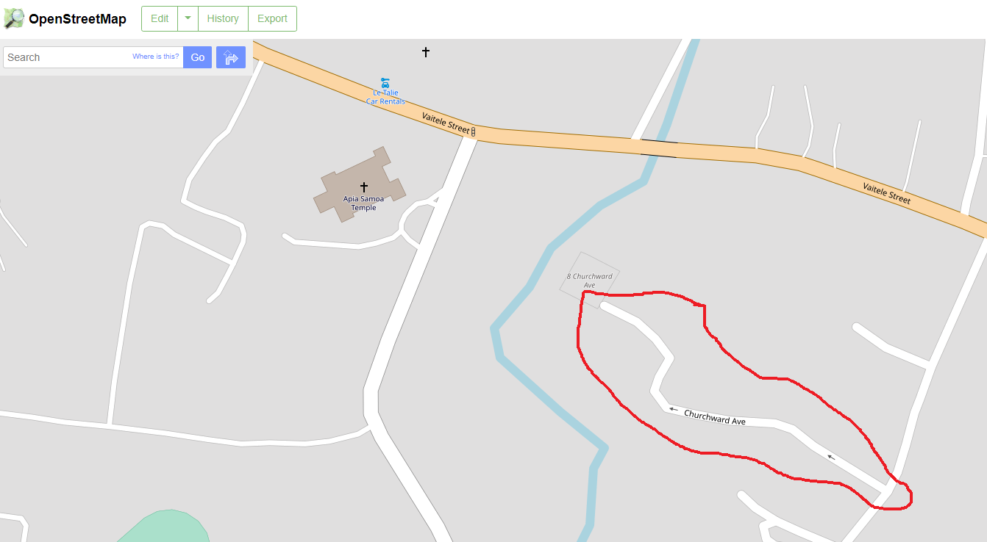
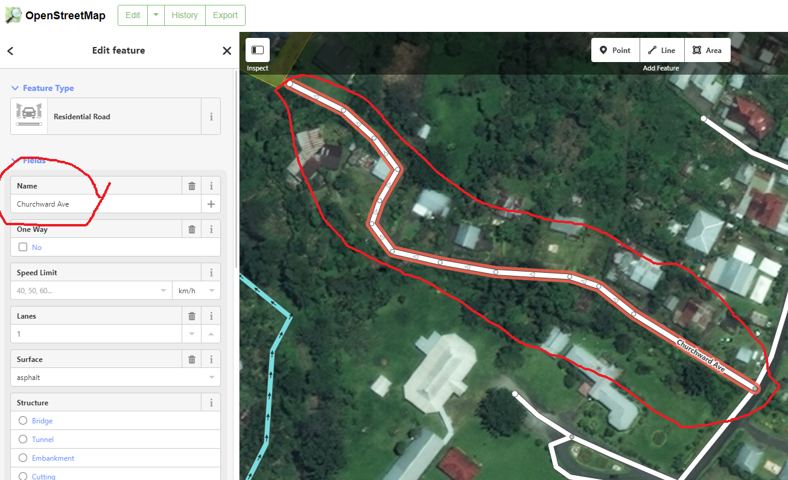
Adding Street Names on Open Street Map for Public Access

Slide 7
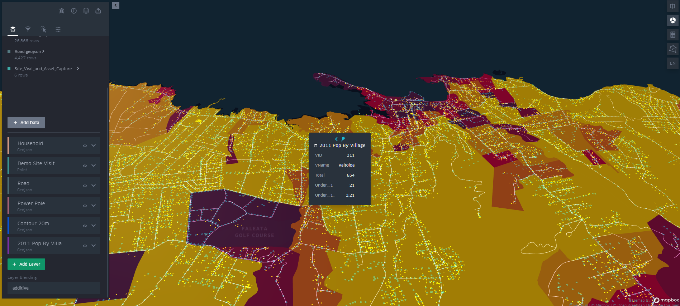
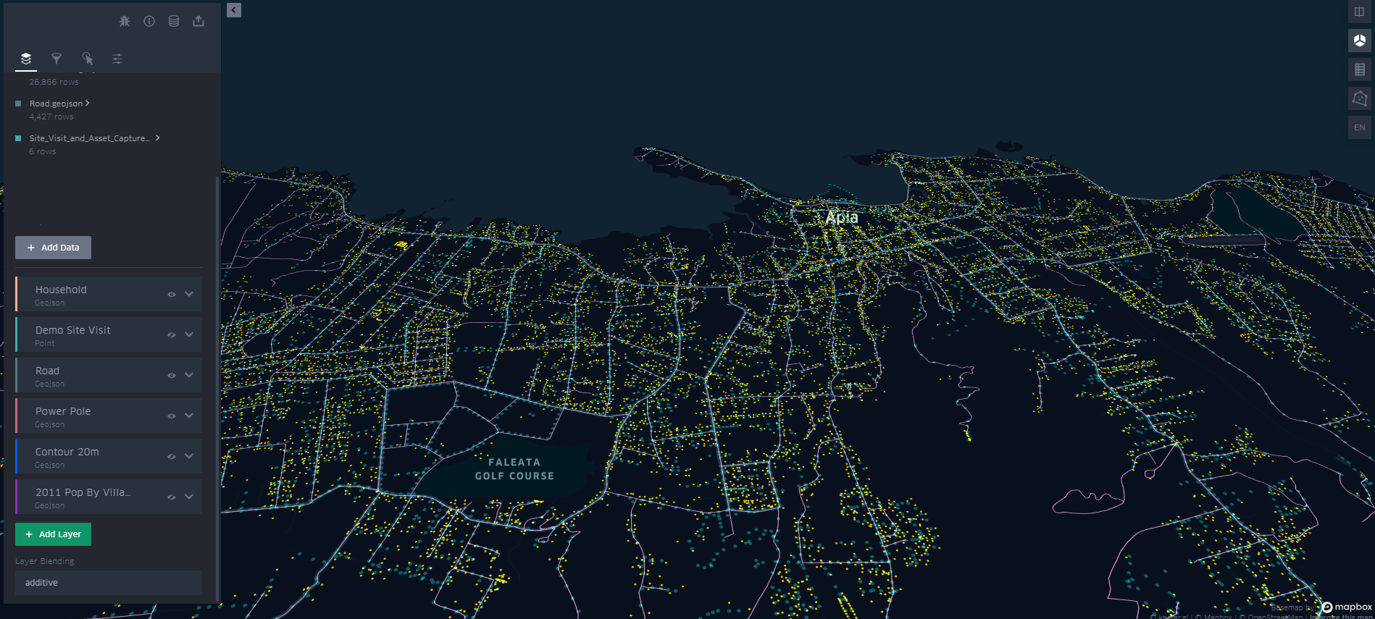
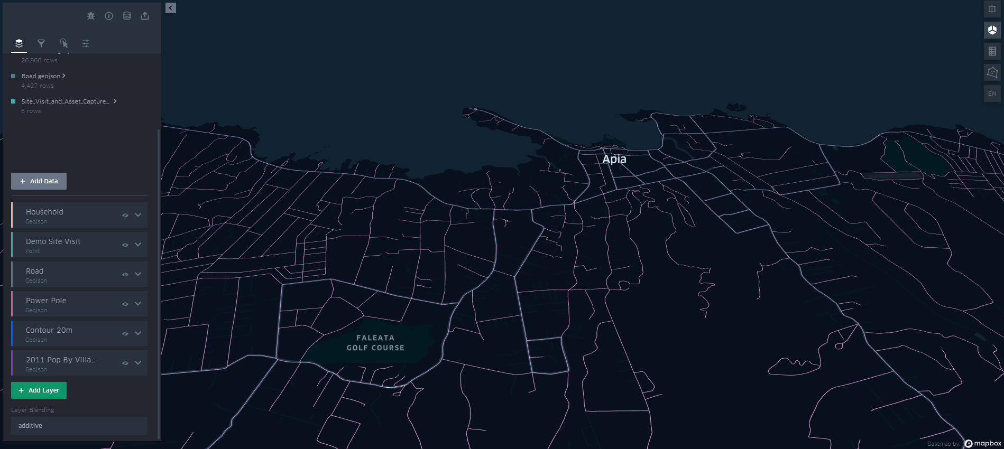
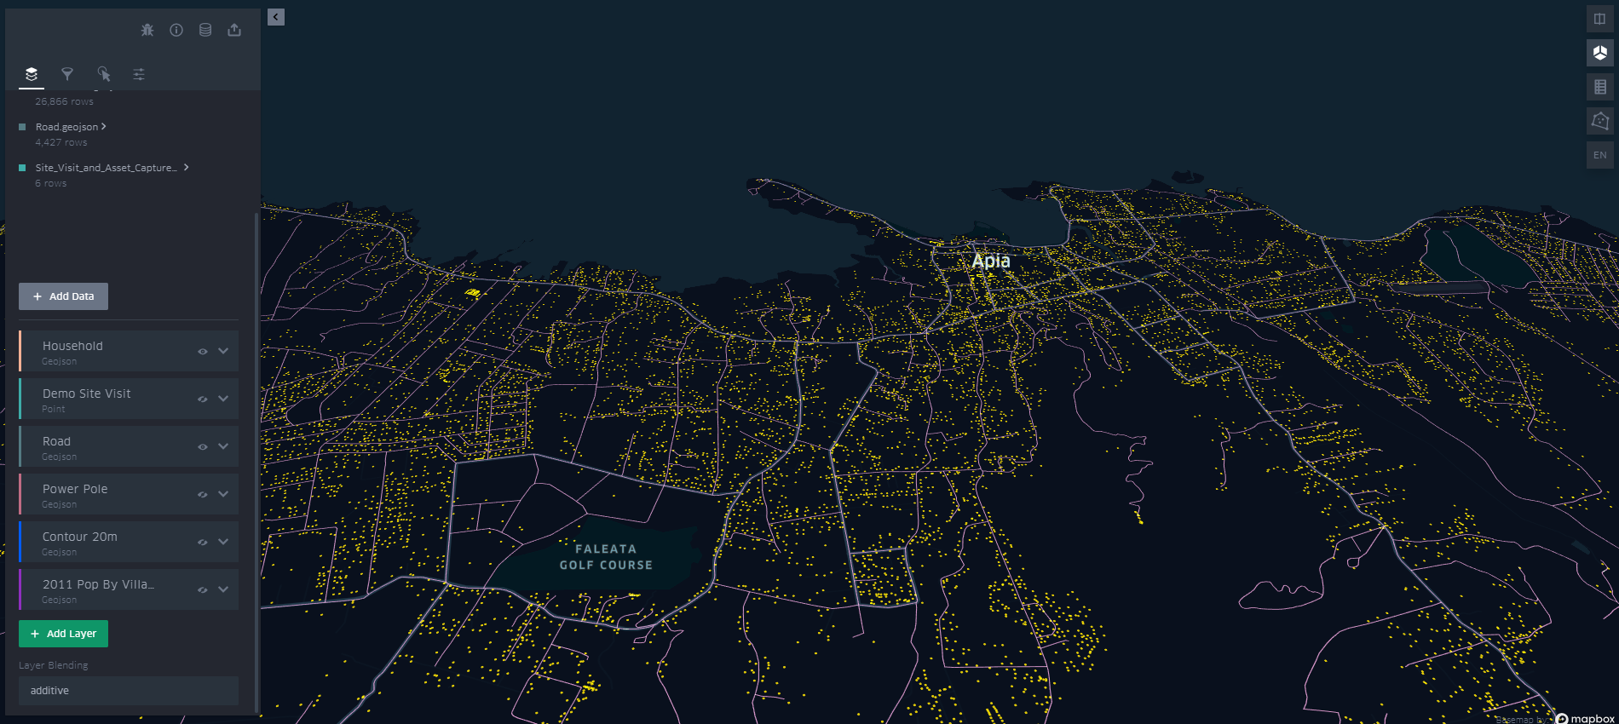
Example GIS Application for Emergency Response

Slide 8
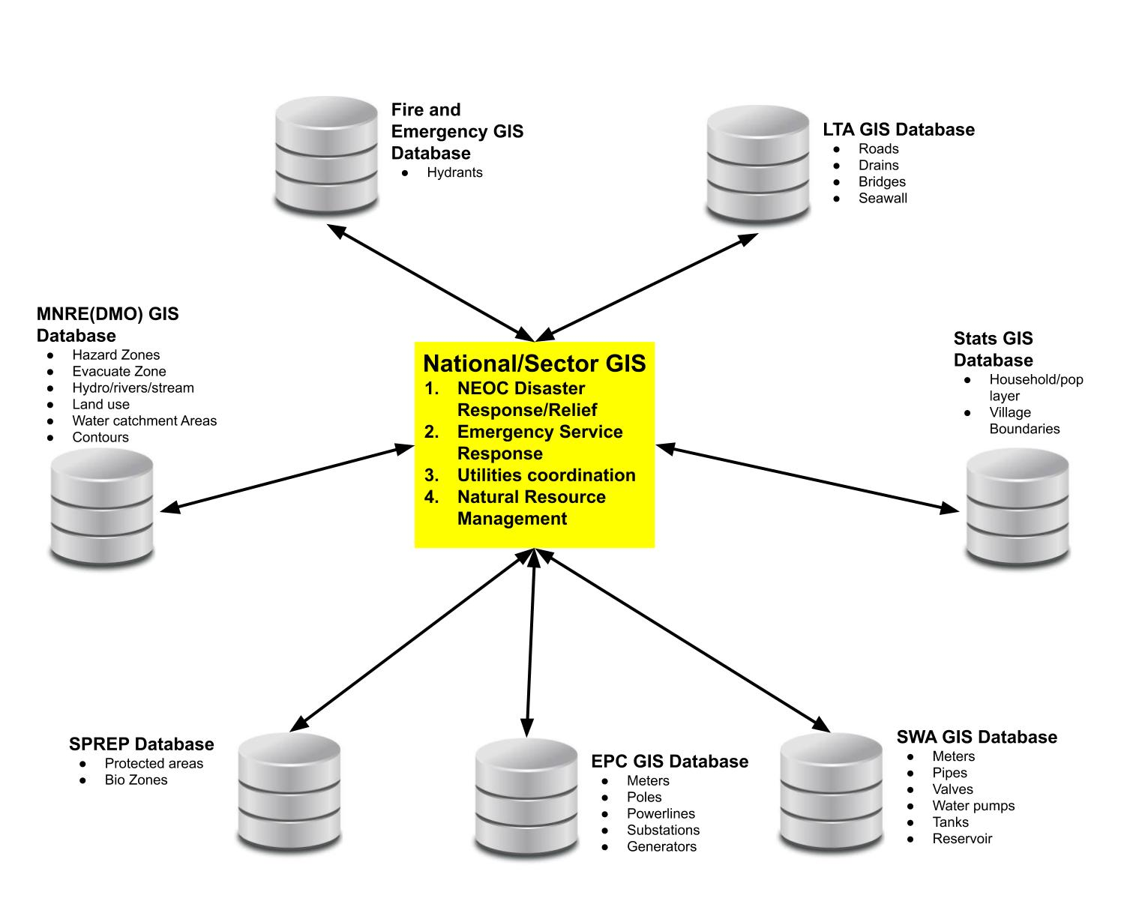
Possible National/Sectoral Application of GIS Architecture

Slide 9
Hosting International/Regional GIS Conference in Samoa
Raise the profile of GIS while contributing to the economy
Expose Samoa to cutting edge Spatial technology
Business and training opportunities

Slide 10
Better Spatial Data/Intelligence for improve decision making
Save time/money/resources
Maximize use of Samoa’s Natural and Man Made Resources
Sustainable development

Slide 11
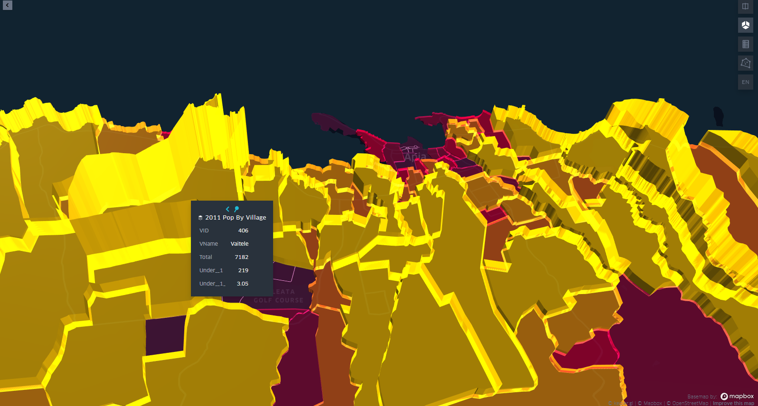
End

Slide 12
Recap
Solid trend of utilization of GIS for significant projects for Samoa
Almost every National, Regional and International project has a significant GIS component.
Geospatial information is multidisciplinary and multidimensional, therefore multiple sectors have interest in accessing the same geospatial information.
SIA Act requires the prioritization of GIS development
An effective GIS User Group is dependent on the decision makers’ commitment to collaborate and implement the SIA Act.
Organisation benefits are numerous but one of the significant benefits is the continuity of projects irrespective of HR dynamics. E.g staff turnover
GIS can help bolster Samoa’s Climate Change Resilience and Disaster Management logistics.
CS Lewis once said, the task of modern educators is not to cut down jungles but to irrigate deserts. With Samoa’s marginal pool of resources, GIS allows us to better plan, innovate and optimize

