Slide 1
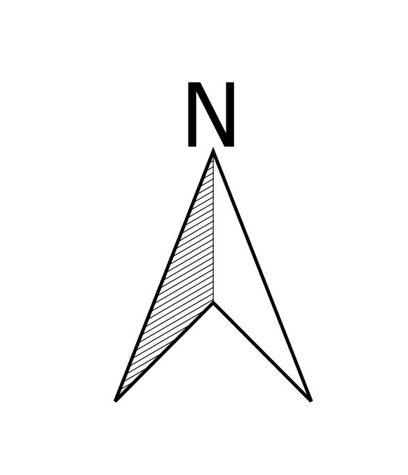
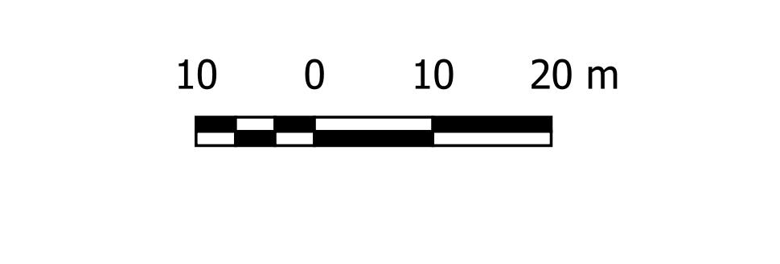
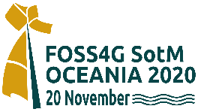

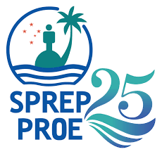

A brief overview of G.I.S. and Remote Sensing in Samoa by James Atherton GIS and Environment Specialist FOSS4G Oceania 2020 Nov 20, 2020

Slide 2
Presentation Outline
Brief history behind GIS and RS development in Samoa
The Spatial Information Agency Act 2010 and the Spatial Information Agency
Current GIS and RS Users/Providers
A few examples of the use of GIS in Samoa
Constraints to the development of GIS in Samoa
The Future of GIS in Samoa...
Notes:
My presentation has six parts…

Slide 3
Brief history behind some GIS/RS developments in Samoa
TIME
1954- today: Air photo surveys on average every 10 years
1990: ANZDEC/DSIR Land Resource Planning- GIS Topographic Layers
1999: AiResearch Mapping GIS Base Data and digital orthophotos
2000: DLSE Coastal Hazards GIS and CIM Database; SWA Network Plans
2001: SamoaTel Network Plans; PWD Road Asset Management System (RAMS)
2002: Statistics Dept Census Maps and Population GIS
2003: MNRE- SamFRIS- Samoa Forest Resource Information System
2004: Samoa GIS User Group First formed and Mapserver launched
2006: EPC Network Plans
2010: Spatial Information Agency Act
2012-16: LIDAR surveys of Samoa
2017: First use of drones for mapping in Samoa
2020: Revival of the Samoa GIS User Group?
Notes:
The first air photo survey of Samoa was done almost 70 years ago in 1954, since then there have been seven more air photo surveys, one every 5-10 years or so. So we can say that remote sensing is not a new technology to Samoa.
However, the very first GIS system was first not developed in Samoa until 1990 when a GIS based land resource planning study was conducted with the assistance of ANZDEC ltd, a New Zealand based consulting firm. The GIS was established at the DLSE and MAFFM and staff were trained in its use and development. Unfortunately cyclone Ofa hit Samoa soon after the system was installed and damaged most of the equipment.
It was not until 1999 when Airesearch mapping, an Australian firm provided high resolution digital orthophotos of Samoa and many new baseline topographic layers, that GIS really began to take off in Samoa. Since then GIS has continued to grow and is now being used by many government ministries and SOEs and the private sector for many mapping and modelling purposes.

Slide 4
Spatial Information Agency Act 2010 (MNRE)
Objectives of the SIA Act: (a) to support the effective and efficient use and sharing of spatial information; (b) to produce and maintain national coverage of topographic maps, marine charts and other remote sensed imagery;
(c) to provide and maintain the geodetic survey system for Samoa; (d) to compile and maintain core spatial databases for Samoa;
(e) to foster the extended use and sharing of spatial information and the growth of the spatial information industry in Samoa;
(f) to protect Government’s interests in all matters of intellectual property and copyright concerning spatial databases and spatial information products
Objectives of the SI Agency (in MNRE):
To implement the S.I.Act including supporting the effective and efficient use and sharing of spatial information; and to enter into relevant agreements for the purpose of the Act.
Notes:
The SIA Act and SIA agency is the key government of Samoa agency for guiding the growth and utilisation of GIS in Samoa. The SIA has 6 related objectives related to preparing and maintaining national spatial datasets as well as promoting the use and sharing of spatial data for the effective and efficient use of such data.

Slide 5
Some current users of GIS and RS in Samoa
MNRE – topographic mapping, cadastre, forest surveys and mapping (SAMFRIS), ecosystems, PAs and threatened species, watershed management, flood modelling, weather forecasting (CLEWS) and many GIS databases
Ministry of Works – RAMS, PUMA
MAF- Soil and land suitability maps, crop suitability maps, farmer databases
Samoa Water Authority, EPC and SamoaTel/Vodafone- Network plans
Samoa Bureau of Statistics- Census mapping
NUS- archaeological mapping
Engineering and consulting firms- project planning and management, EIAs
Conservation NGOs- env.management, planning PAs and CAs
SkyEye- vehicle tracking, drones
Maua- online shopping and delivery services
Notes:
Many Govt departments are now using GIS:
MNRE: perhaps the most important provider of GIS data is the MNRE who are the main mapping agency and are responsible for the air photo and topographic data. Much of this information is now available in digital form. The MNRE also have a sophisticated database of forests and forest assets, coastal hazards, climate data, cadastral data and other datasets
Other users of GIS/RS data include:
Ministry of Works have the Road Asset Management System to store information about public works assets such as roads, bridges, culverts etc
Samoa Water Authority: who have a GIS system for pipelines and other assets such as boreholes, hydrants, valves, etc
Samoa Telecommunications: who have a GIS for the telecommunication supply network
Electric Power Corporation: have a GIS for the power supply network
Samoa Bureau of Statistics: who have a GIS of census districts, down to the sub-village level and household locations
MAF have a GIS for planning agricultural development including soil and crop suitability etc
Skyeye are one of the few private sector organisations using GIS and are using it for vehicle tracking, land cover mapping using drones and most recently for helping producers and vendors sell their products via a GIS based delivery service called Maua

Slide 6
Uses of RS/GIS in Samoa
Still Mainly for Cartographic Output (maps)
Use of GIS for Planning, Monitoring, Research, Spatial analysis, and Decision Making still underutilised…
Notes:
At the current time most GIS users in Samoa are using it for cartographic output- ie maps. There is limited use of GIS for the more sophisticated tools such as monitoring, research, spatial analysis, planning and management. The future of GIS development in Samoa will depend on us moving from the simple map outputs to using it for planning, management and hopefully, decision making.

Slide 7
Some brief examples of GIS use in Samoa
1. Coastal infrastructure management- MNRE
2. Census mapping- Samoa Bureau of Statistics
3. Predicting impacts of climate change on forest ecosystems- MNRE
Notes:
I would like to a give three simple examples where GIS has been used to help in decision making for various projects in Samoa, mostly from my own experience but there are numerous other examples of the use of GIS from flood modelling to mapping ecosystems and threatened biodiversity to modelling measles etc
A major application of GIS in Samoa is in Coastal Infrastructure Asset Management: coastal hazard zone mapping and developing coastal infrastructure management plans for roads, bridges and other coastal infrastructure. Another important application is for planning statistical surveys and mapping statistical data. A third application is for pedicting impacts of climate change on forest resources.

Slide 8
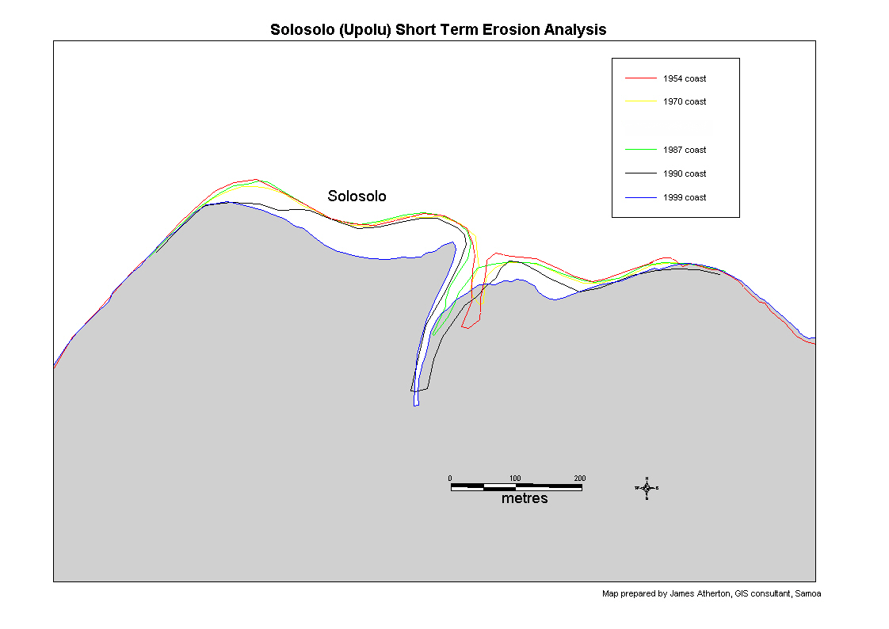
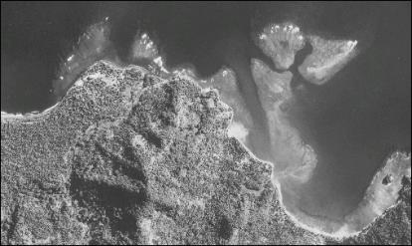
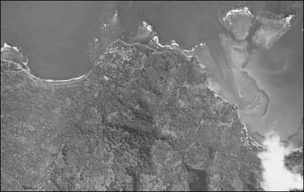
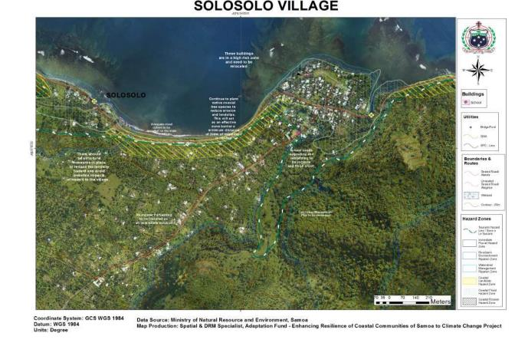
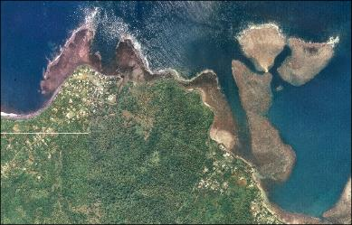
Example 1- Coastal Erosion Analysis and Coastal Infrastructure Management
1954
1970
1999
Notes:
A World Bank funded project focused on the management of coastal infrastructure and the identification of coastal hazards around the entire coastline of Samoa in 2001 and again in 2018
One of the main determinants of coastal hazard is coastal erosion.
Key points:
Can scan and register a series of historical aerial photos to the 1999 photomap
Can digitise coastlines from the historical aerial photos
Can then overlay the coastlines and determine coastal erosion rates between each reference year
Hazard zone maps are then used to plan coastal protection works and changes or movements to infrastructure needed to cope with future climate change and sea level rise

Slide 9
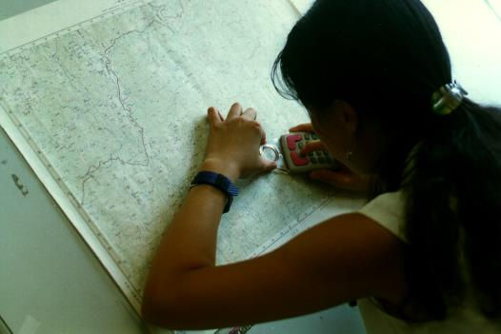
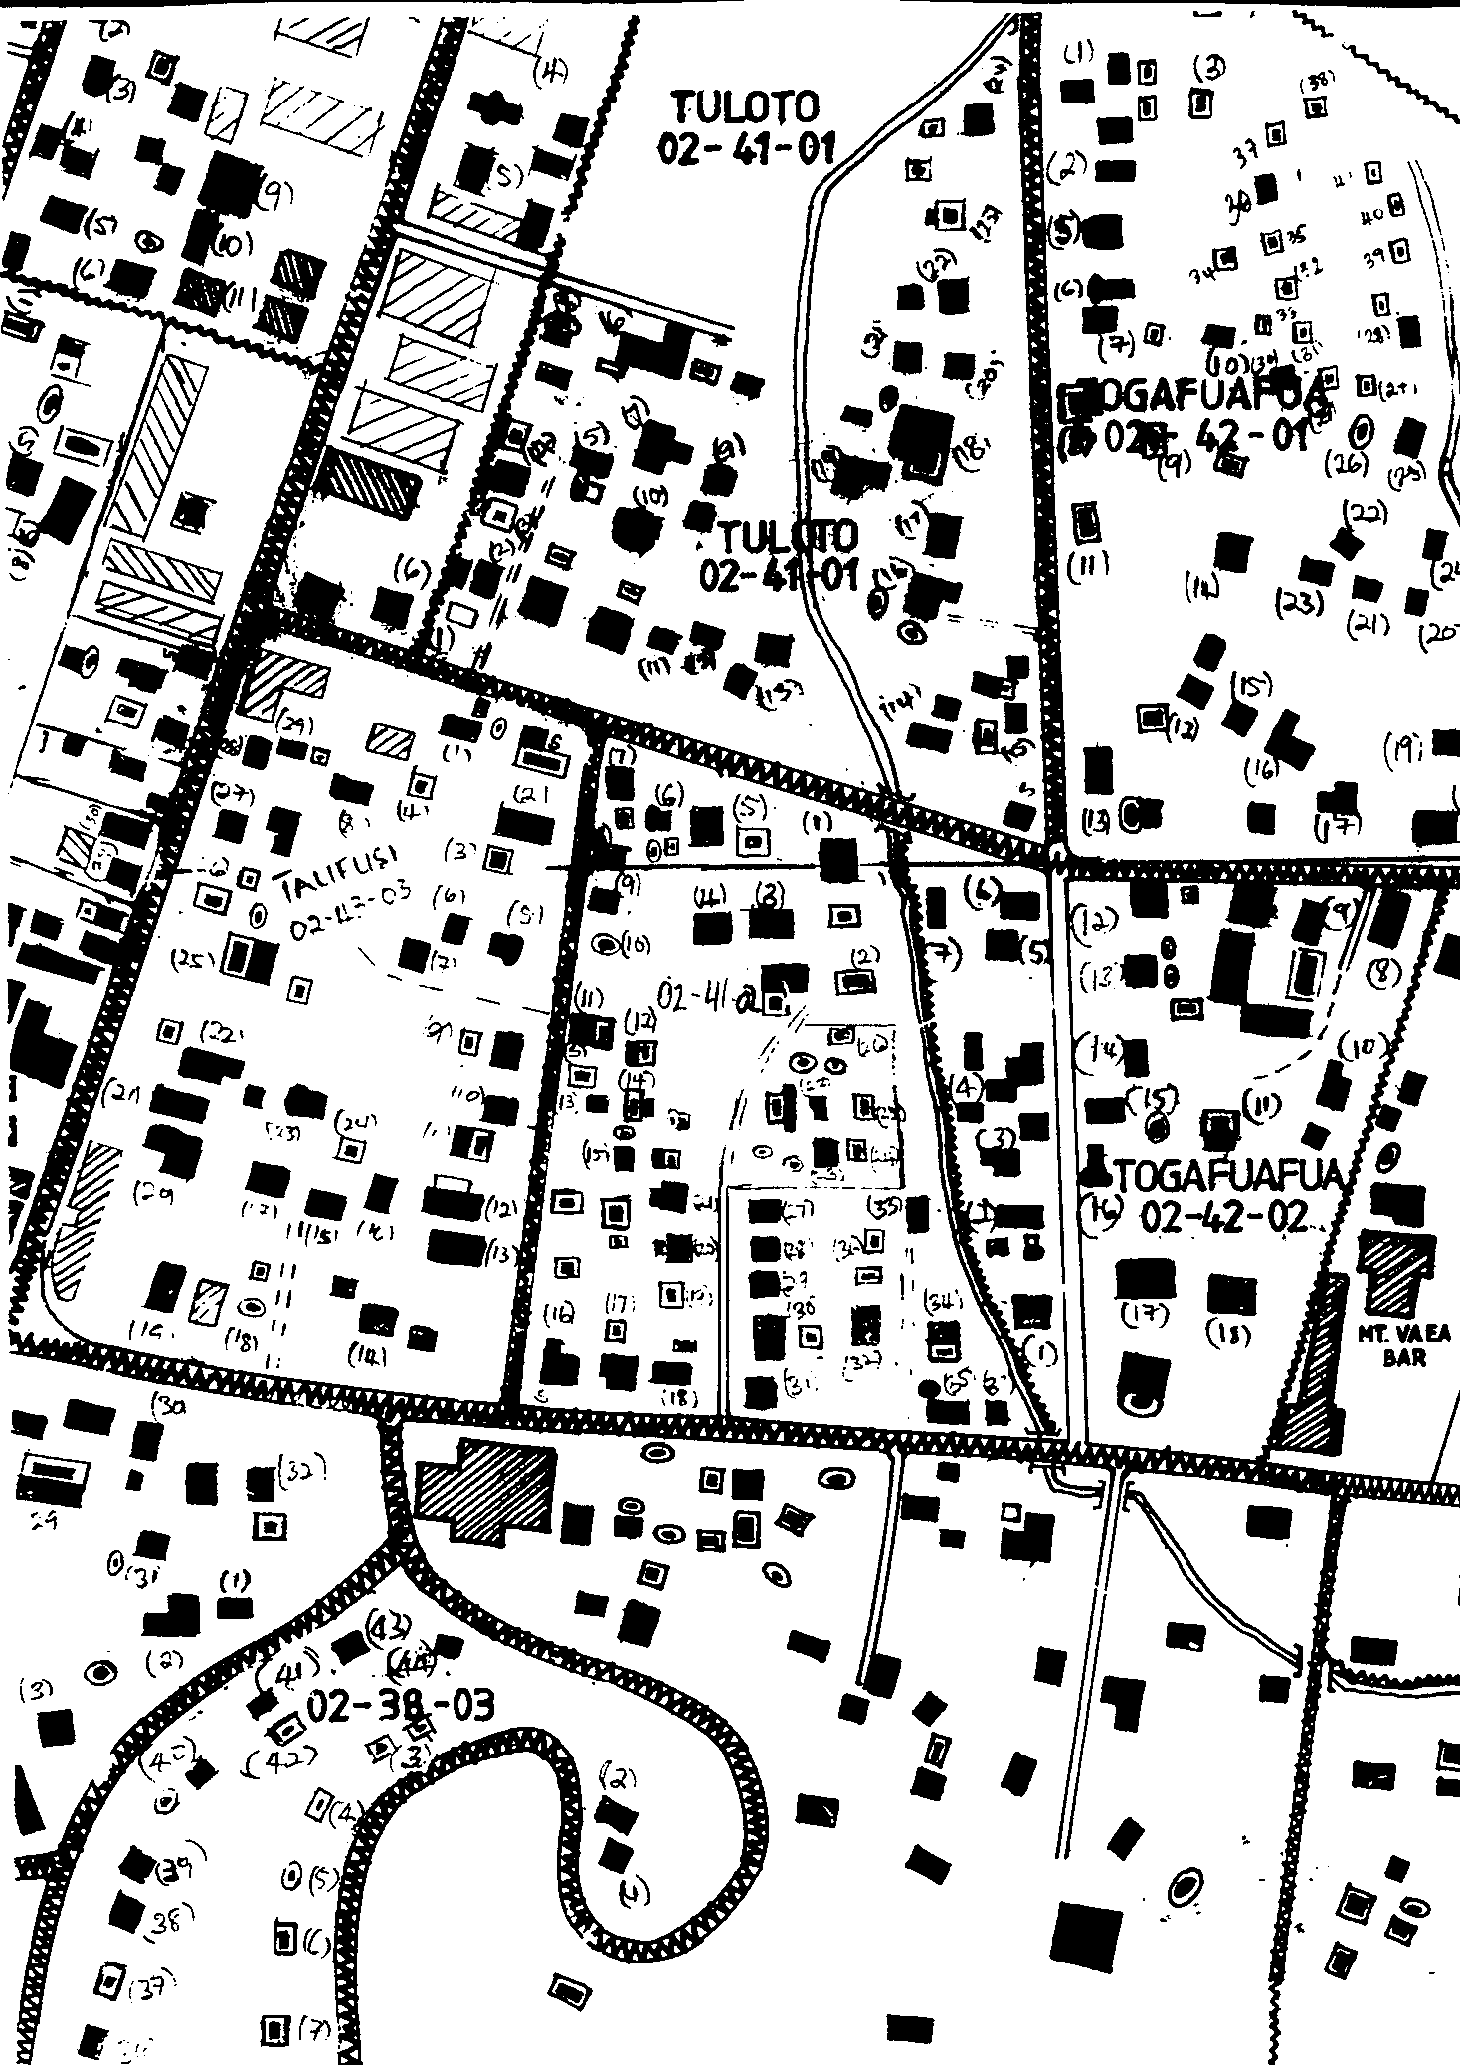
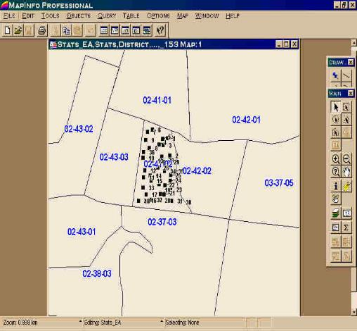
Example 2- Census Mapping
Digitisation
GIS Data in MapInfo
EA maps on paper
Notes:
The Stats GIS essentially involved digitising about 100 map sheets including about 880 enumeration areas and about 20,000 households into a MapInfo based GIS. There are two main reasons why this was done:
help plan census and other surveys
to map findings and census data

Slide 10
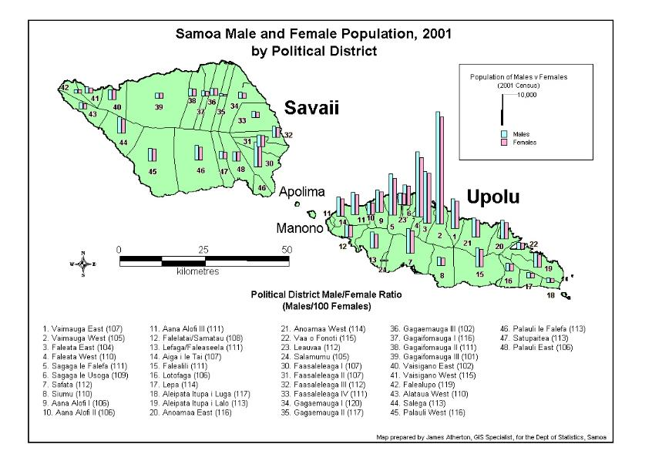
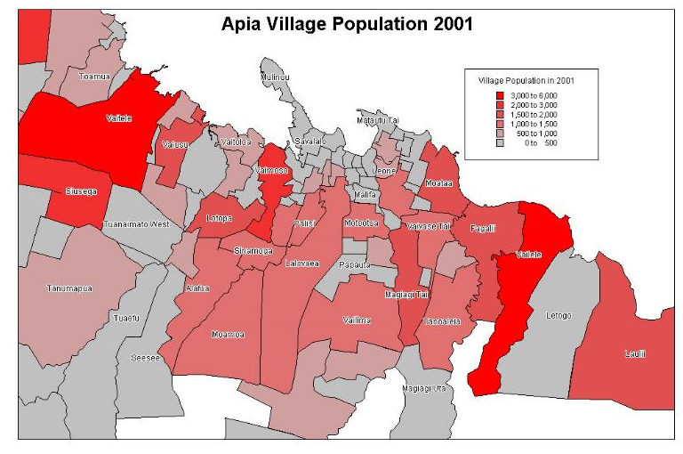
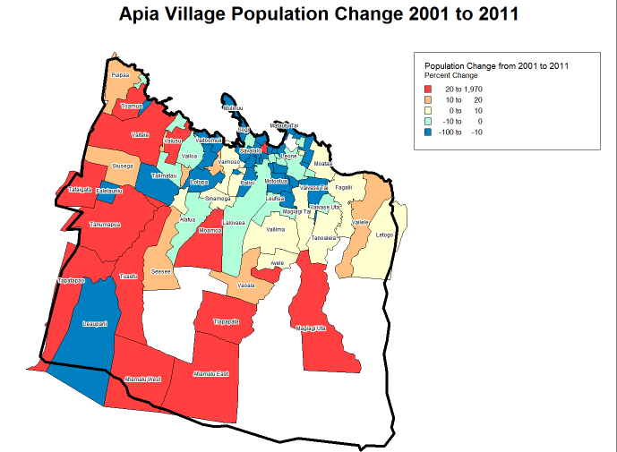
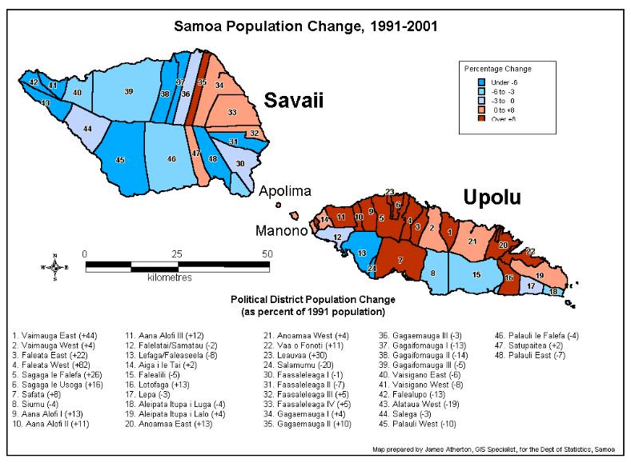
Output map examples
Notes:
Some of the output maps are shown here.
As they say, a picture speaks a 1000 words and that is especially true for statistical information. The first map shows the ratio of males to females in political districts during the 2001 census. Interestingly, in every district except one in Samoa males outnumber females, so not good news for some of us…
The second map shows the distribution of population in Apia. We can see that the villages with the greatest population are at the edge of Apia in Vaitele and also Vailele. This is probably related to the land that the Govt is selling in both these villages. Finally we can look at overall population change in difft districts and see that in most districts on Savaii the population is decreasing while Northern Upolu’s population is increasing rapidly.
Each of these maps is called a thematic map because it portrays some thematic information.
These data can be mapped at whatever scale you like from the EA level to district level to the regional and finally the national level.

Slide 11
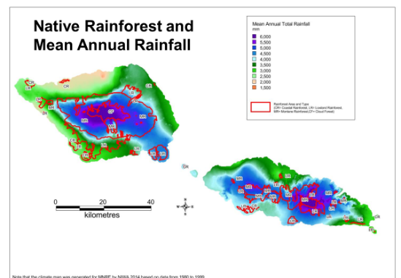
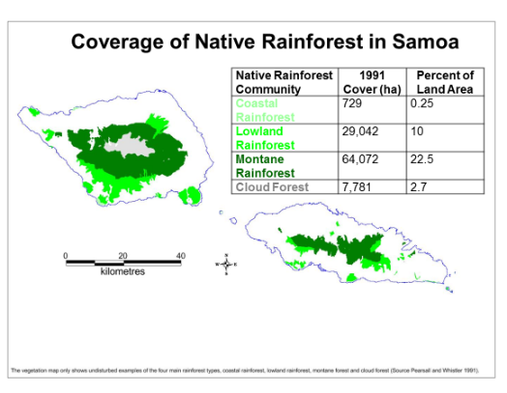
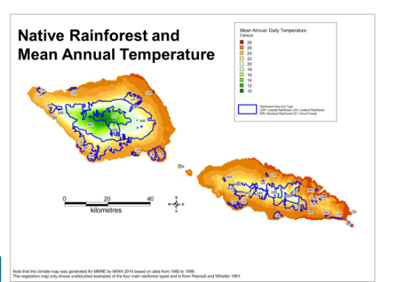
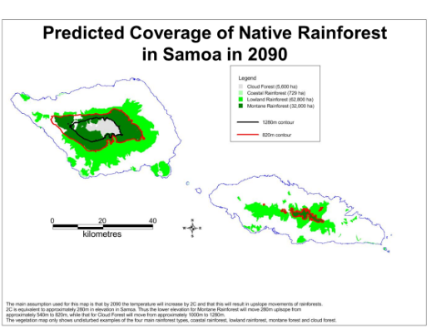
Example 3- Predicting forest change in future climate
Notes:
One developing application of the spatial technologies is in helping us to understand and predict possible impacts of climate change on our natural resources. For example we believe that two important determinants of plant communities in Samoa are rainfall and temperature. We can overlay plant communities onto rainfall and temperature maps and look for patterns. We know that in the future Samoa is likely to be warmer and a bit wetter and with more unpredictable rainfall. GIS maps have been prepared showing future climate for Samoa in 2090. We can make educated guesses of the change in plant communities in the future under these new climate regimes. In general we believe that vegetation communities will move upslope as the temperature rises… but what does that mean for the plant communities at the tops of mountains… ?

Slide 12
Predicted changes in areas of 4 main rainforest communities between 2015 and 2090
Predicted change in area
2015
2090
1860m
Cloud
Forest
Cloud
Forest
1000m
Montane
Forest
Montane
Forest
540m
Lowland
Forest
Lowland
Forest
150m
Coastal Forest
Coastal Forest
0m
Elevation
Notes:
Rainforest communities are likely to move upslope and become smaller in area especially the cloud forest which has nowhere to migrate to… The possible exception is the lowland forest which may benefit from higher temperature and move upslope at the expense of the montane forest

Slide 13
Constraints for GIS Development in Samoa
Low priority given to integrated GIS development at a national scale
Lack of metadata documentation on GIS layers held by different providers and users
Lack of collaboration/sharing between users
Lack of standards/protocols/MOUs for data documentation, sharing and pricing
GIS training has not always been applied and is quickly lost
Notes:
Although GIS use has grown significantly in Samoa since it was first introduced 30 years ago, there is still a long way to go before we can say that the technology is being used very effectively in Samoa. Some of the main constraints to GIS development are:
Low priority given to the integrated development of GIS across sectors and a lack of understanding of the technology and its application by senior management. Although awareness of GIS is growing there is still a lack of appreciation of what it can do and how it is useful. Perhaps there has been too much emphasis on the technology and not enough on its application. Most of the GIS development projects in Samoa have been donor driven not driven from within Government.
Lack of metatadata documentation on GIS layers held by different users. Until everyone documents there data properly we cannot be sure what datasets are out there and who has them. This is particularly important if we want to maintain some kind of “institutional memory”.
Lack of collaboration/sharing between users. There is only limited and informal collaboration between data users at the moment. Until GIS users start talking to each other we run the risk of reinventing the wheel and developing datasets that already exist. Collaboration can also result in professional development and sharing of expertise and ideas. It may also help increase the status and influence of GIS specialists as a profession
Lack of standards/protocols for data development, documentation and pricing. Without protocols for data development, documentation and pricing we cannot be sharing data effectively. To encourage data sharing we need to be creating data following the same data formats, projections and naming rules and with a reasonable pricing system.

Slide 14
The Future...
A revised GIS User group!
Standards/protocols for data documentation, storage and sharing
Development of MOUs and increased collaboration between GIS Users
Increased use of drones
Increased use of FOSS- eg QGIS, OSM
More GIS training courses available online
Increased use of the technology in new fields- eg health, retail, shopping, fleet management
Notes:
What does the future hold of GIS and RS in Samoa? Well here are some predictions:
1. Samoa GIS Users group has just been reformed. Many of the constraints that I just mentioned can be targeted by the user group. Such groups normally have two major functions:
Establish standards for GIS data creation and, b) Promote collaboration between agencies
Other future developments include:
The increased use of drones as a major source of remotely sensed imagery. The costs of drone technology keeps coming down while the resolution of the imagery goes up. This will continue and in a few years time drones rather than aerial photography or satellite imagery may be the main source of remotely sensed data in Samoa.
The increased use of free and open source software for GIS- such as QGIS and Open Street Map etc
More GIS training courses available online and in person
The use of the spatial technologies in new fields such as in epidemiology (eg measles and covid management), the retail industry, shopping (eg Maua) and fleet management etc

Slide 15
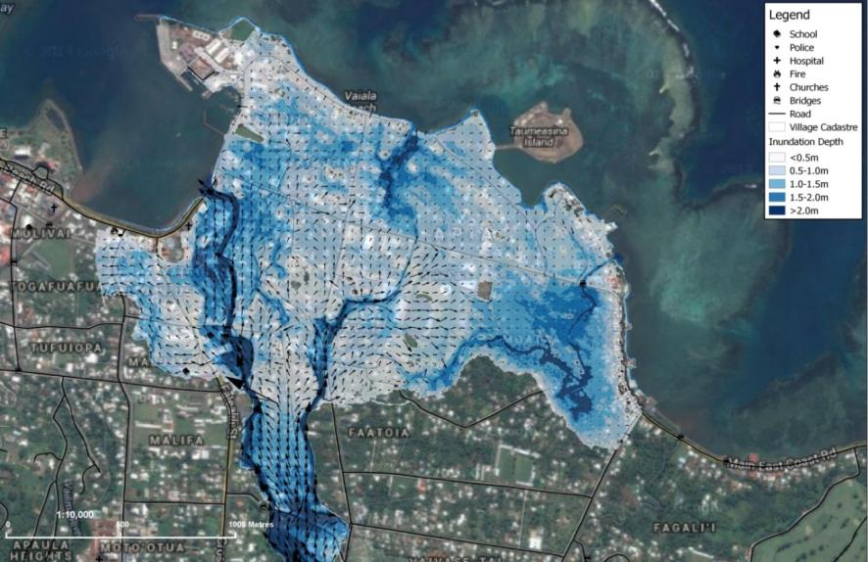
Thank you for listening...

