Slide 1
Friday 20th November 2020
Pacific Climate Change Centre, Apia
Notes:
Welcome – big turnout – proof of high interest and need
Setting the scene
Conference hosts: SPREP in collaboration with SkyEye Samoa

Slide 2
Acronyms...
Foundation
Open Source Geospatial Foundation
foster and promote the adoption of
open source geospatial technology
supports the development of
a free and open editable world map
Event
FOSS4G
Free and Open Source Software for Geospatial
SotM
State of the Map
Notes:
A lot of strange letters…
2 foundations, each organizing an event
FOSS4G SotM Oceania is the regional chapter of the larger global community - the chance to merge the two conferences into one Oceania centred event.
Encouraging the growth, development and distribution of free geospatial data and to providing geospatial data for anyone to use and share

Slide 3
Melbourne AU, Nov 2018
Wellington NZ, Nov 2019
Suva FIJI, Nov 2020
Hybrid online/in-person
Notes:
FOSS4G - International conferences since 2006.
This is the 3rd regional conference – the first time hybrid “online/in-person”.

Slide 4
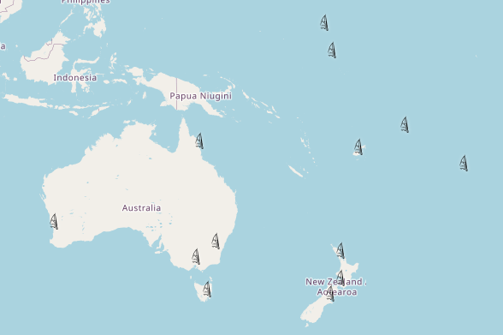
Local Hubs
Apia, Samoa
Auckland, New Zealand
Bairiki, Kiribati
Cairns, Australia
Canberra, Australia
Christchurch, New Zealand
Hobart, Australia
Majuro, Marshall Islands
Melbourne, Australia
Perth, Australia
Rarotonga, Cook Islands
Suva, Fiji
Wellington, New Zealand
Notes:
More than 10 local hubs, from Perth to Rarotonga – where people are coming together for this conference. A lot of participants and local content!
Different time zones – cf. Live stream

Slide 5
Time | Programme
9:30-10:30am | Introduction on GIS Importance of GIS for decision makers
10:45am-12:00pm | GIS User Group Meeting History of the GIS User Group in Samoa Why revive the GIS User Group?
12:00-1:00pm | GIS User Cases and Application
Lunch
2:00-3:00pm | Open GIS Data – OpenStreetMap Pacific
3:00-5:00pm | Parallel Session 1 FOSS4G Keynote speakers Live stream | Parallel session 2 GIS User Group Network
5:00pm | Closing Remarks
Cocktail
Notes:
Overview of the programme.

